Slide 1
中国环境保护与社会发展研究
Study on China’s Environmental Protection and Social Development
国合会2013年年会
CCICED AGM 2013
2013.11.15

Slide 2
1.问题的提出 Problem Statement
2.中国现状 The Current China Situation
5.政策建议 Policy Recommendations
3.国际视角 Perspectives From International Practice and Theory
4.政策和行动框架 A Framework for Policy and Action
6.结论与展望 Conclusions and Outlook
中国环境保护与社会发展研究
Study on China’s Environmental Protection and Social Development

Slide 3
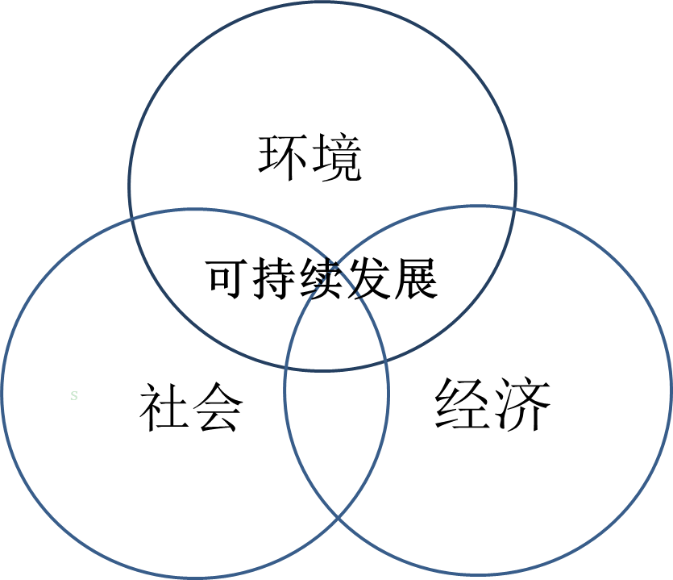
1.问题的提出 Problem Statement
经济、社会和环境是可持续发展三个不可或缺的部分
Economy, environment and society are the three pillars of sustainable development
中国改革开放后一直将经济发展作为战略规划和决策的重点
Since the start of its reforming and opening up process, China has prioritized economic growth in its strategic planning and policy making
实现生态文明的美好愿景需要处理好环境保护与社会发展的关系
Achieving the vision of ecological civilization requires policies that understand and address environmental protection and social development in a coherent manner.
提出了促进环境保护与社会发展相协调的短期和长期政策框架，并为开展后续研究提出了建议
Proposed short and long-term policy framework to promote coordination of environmental protection and social development and recommendations for follow-up researches.
ENVIRONMENT
s
Sustainable
Development
SOCITY
ECONOMY

Slide 4
2.中国现状 The Current China Situation
环境污染引发群体性事件增多
Increasing mass incidents caused by environmental problems
环境恶化造成公共健康危害
Public health hazards caused by environmental degradation
环境破坏与贫困形成恶性循环
Vicious cycle between environmental degradation and poverty
环境问题带来新的社会不公
New social injustice brought about by environmental issues
城镇化快速发展使资源环境压力持续增加
Mounting pressure on resources and the environment in the rapid urbanization

Slide 5
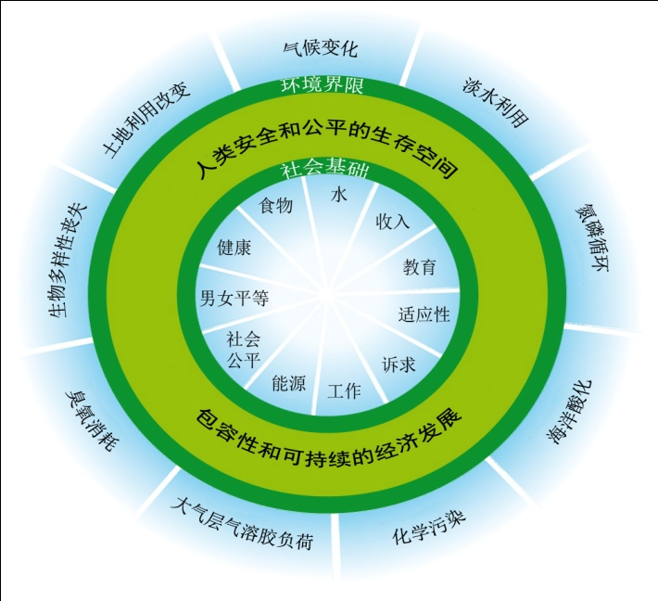
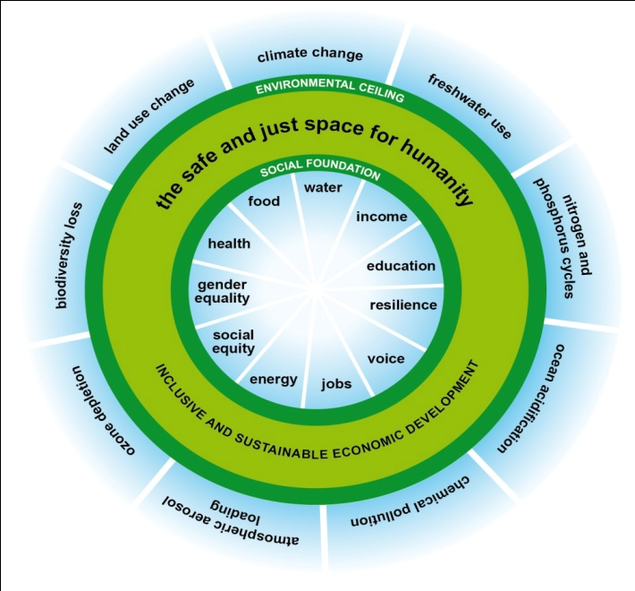
3.国际视角 Perspectives From International Practice and Theory
工业革命以来环境与社会互动发展的历史回顾
A historical review on Environmental protection & social development since the Industrial Revolution
国际上主要关注 以下领域：环境与贫困，环境与人口，环境、移民和城市化问题，环境与健康，环境与就业，环境与社会公平，环境与可持续消费
Key policy issues and research fields include: environment and poverty, environment and population, environment, migration and urbanization, environment and health, environment and employment, environment and social justice and environment and sustainable consumption
如何理解环境与社会之间的关系？
How to understand the relationship between environment and society？
可持续发展框架下三个维度的全面认识
Comprehensive understanding of three dimensions under the framework of sustainable development
内嵌式的方法
Embedded method

Slide 6
4.政策和行动框架 A Framework for Policy and Action
制定政策的基本原则
Basic principles
多方参与
Multi-party participation
长期与短期目标相结合
Long-term and short-term combination
政策目标一致性
Goal congruence
以法制为保障
Legal guarantee
公平正义
Equity and justice

Slide 7
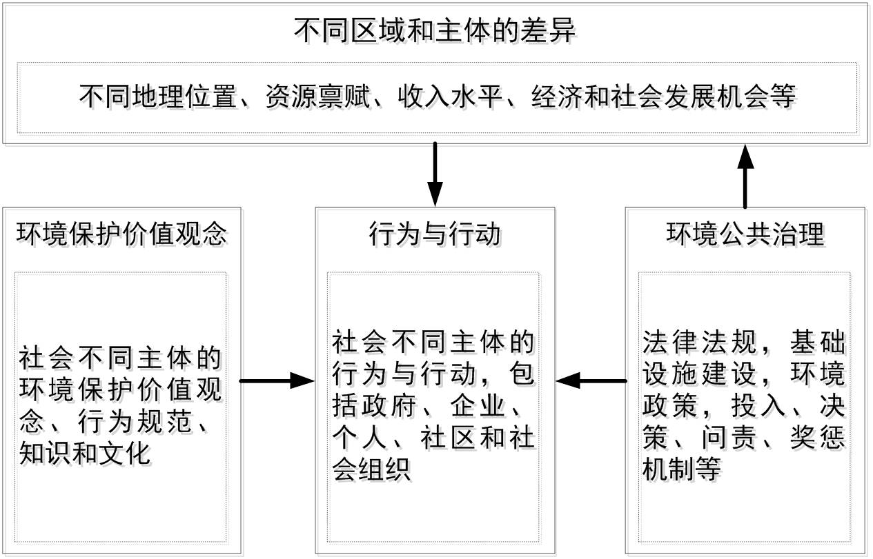
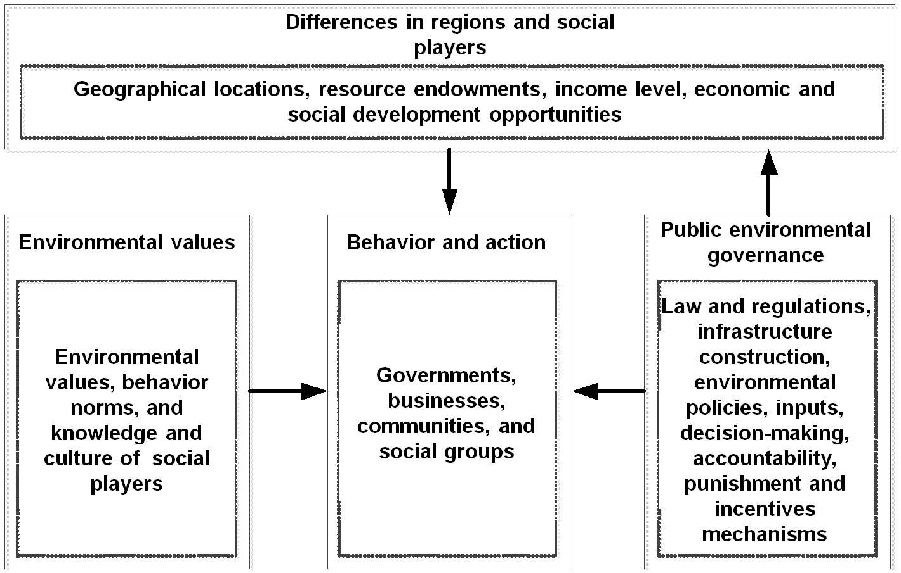
4.政策和行动框架 A Framework for Policy and Action
从三个维度协调环境保持与社会发展的关系
Coordinating the relationship between environmental protection and social development from three dimensions

Slide 8
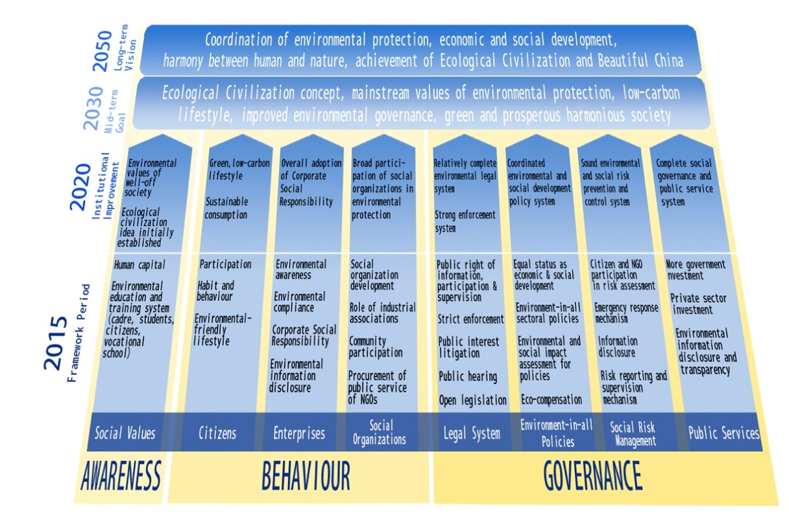
5.政策建议 Policy Recommendations
建议1：提出2050年愿景并制定实现愿景所需的阶段性政策和行动计划
Recommendation1: Elaborating a 2050 vision and developing a phased plan of policy and actions that will be essential in achieving that vision

Slide 9
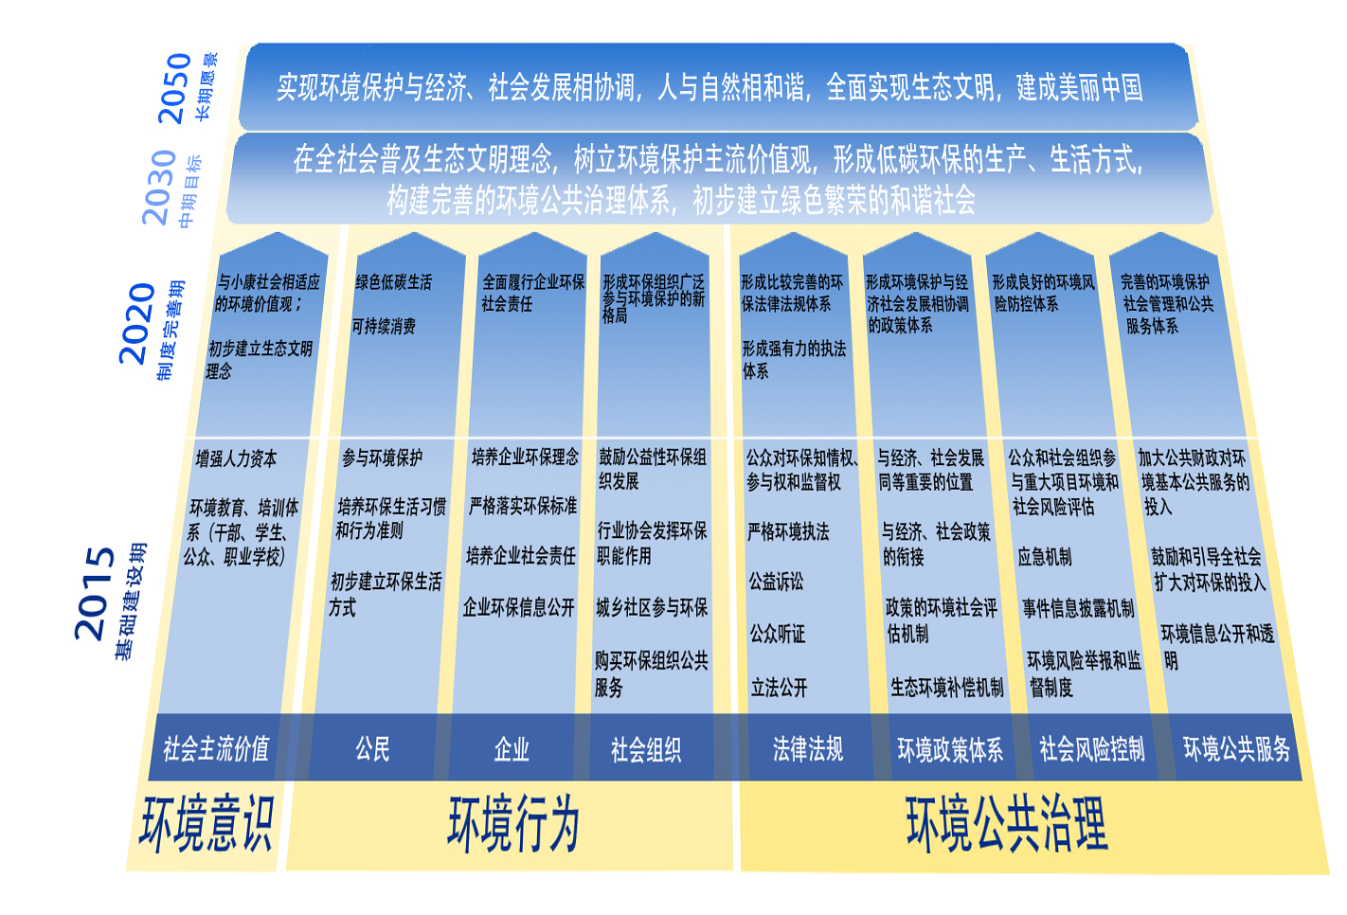
5.政策建议 Policy Recommendations

Slide 10
5.政策建议 Policy Recommendations
建议2：形成生态文明的社会规范和价值观
Recommendation 2: Promoting social norms and values related to ecological civilization
制定教育和培训计划
Developing education and training plans
支持理论和政策研究
Supporting conceptual and policy-oriented research
运用多种媒体广泛传播生态文明价值观
Promoting values related to ecological civilization through extensive use of media

Slide 11
5.政策建议 Policy Recommendations
建议3：鼓励各类社会主体发挥作用
Recommendation 3: Encouraging all in society to exercise their appropriate roles
鼓励健康、可持续的生活方式
Advocating healthy and sustainable life styles
公众参与决策过程
Public participation
促进企业履行环境社会责任
Promoting acceptance by enterprises of their environmental and social responsibilities
支持环保社会组织进一步发展
Supporting the further development of environmental and social organizations

Slide 12
5.政策建议 Policy Recommendations
建议4：全面改进整个政府的公共治理
Recommendation 4: Strengthening public governance
制定经济、社会和环境“十三五”规划和年度计划报告
Developing 13th FYP and annual planning report on economy, society and environment
建立重大政策的环境社会评估机制
Establishing environmental and social evaluation mechanism of major policies
将环境保护成效纳入政府绩效考核评价体系
Incorporating environmental protection results into the government performance appraisal system

Slide 13
5.政策建议 Policy Recommendations
建议5：建立环境保护社会风险评估、沟通和化解机制
Recommendation 5: Establishing a sound mechanism to assess, communicate, and mitigate the social risks of environment protection
建立征求和吸纳民意的规范程序
Establishing standardized procedures to solicit and incorporate public opinion
建立环境社会影响问责制
Establishing environmental and social impact accountability
构建突发环境事件的应急机制
Building environmental emergency mechanism
提高环境信息的公开性和透明度
Improving the openness and transparency of environmental information

Slide 14
5.政策建议 Policy Recommendations
建议6：提高环境基本公共服务水平
Recommendation 6: Improving the level of public environmental services
保证环境基本公共服务均等化
Ensuring the equalization of public environmental services
通过购买服务提高环境基本公共服务水平
Improving the level of public environmental services through the purchase of services
逐步提高环境基本公共服务在财政支出中所占比重
Gradually raising the share of public environmental services in financial expenditure
建立生态补偿机制
Establishing ecological compensation mechanism

Slide 15
6.结论与展望 Conclusions and Outlook
认识社会发展与环境保护两者之间的关系将有助于中国制定行之有效的政策，避免各种意想不到的后果。中国政府在这些方面的成就将吸引许多国家和国际组织的关注。
Understanding this relationship will allow China to better develop effective policies that will avoid unintended consequences. The achievements made by the Chinese government in these areas will attract attention from many other nations and international organizations.
课题组开展的仅是初期框架性研究，下一步应当重点研究的问题包括：
Task Force has only carried out the initial framework study and follow-up research priorities include:
如何促进生活方式和行为方式转变
How to promote the changes in lifestyles and behavior patterns
如何奠定社会和环境相协调的法律基础
How to lay the legal basis for coordination of environmental protection and social development
如何保证环境保护和社会发展相协调的资金资源
How to ensure the financial resources for coordination of environmental protection and social development

Slide 16
谢 谢 ！
Thank You !

