Slide 1
可持续消费与绿色发展
Sustainable Consumption and Green Development
报告人：徐庆华，迈克尔·昆特
XU Qinghua & Michael KUHNDT
2013年11月15日 15 November 2013

Slide 2
国合会可持续消费与绿色发展课题组
CCICED Task Force on Sustainable Consumption and Green Development

Slide 3
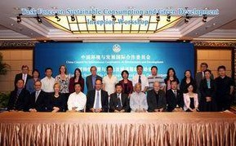
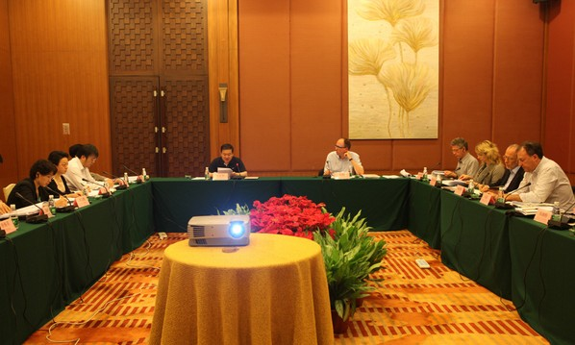
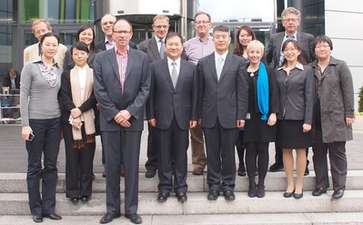
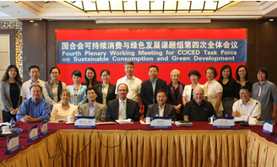
主要活动 Principal Activities
2012年9月，项目启动会暨课题组第一次全体会议
Sep. 2012, Inception Workshop (First Plenary Working Meeting)
2013年1月，课题组第二次全体会议
Jan. 2013, Second Plenary Working Meeting
2013年5月，课题组第三次全体会议暨海外会议与交流
May 2013, Third Plenary Working Meeting and International Study Tour
2013年9月，课题组第四次全体会议
Sep. 2013, Fourth Plenary Working Meeting
2013年11月， 国合会年会 Nov. 2013, CCICED AGM

Slide 4
课题背景 Background
不可持续的消费模式引起日益恶化的城市空气污染和日益增加的城市垃圾。
Unsustainable consumption patterns have resulted in worsening urban air pollution and increasing municipal waste.
中国整体生产生活方式正在转变、经济结构正逐步调整。
The overall production mode and living style are changing and economy is restructuring in China.
提出生态文明建设，完善了制度环境。
Ecological civilization development improves institutional context.
城镇化发展为可持续消费发展带来巨大机遇。
Accelerated urbanization presents golden opportunities for the development of Sustainable Consumption.

Slide 5
课题目标与任务 Project Objectives and Tasks
1
可持续消费与生产的基本理念
Principles of Sustainable Consumption and Production
2
中国可持续消费的政策与未来趋势
Sustainable Consumption Policies and Trends in China.
可持续消费的国际经验与启示
International Experiences and Inspiration for Sustainable Consumption in China.
3
中国可持续消费与绿色发展战略建议
Recommendations for China’s Sustainable Consumption and Green Development in China.
4

Slide 6
可持续消费与生产的基本理念
Principles of Sustainable Consumption and Production
可持续消费包括以经济、社会和环境可持续的方式满足今世后代对商品和服务的需求。
政府应制定和执行可持续消费政策, 以及将这些政策同其他公共政策相结合。
Governments should promote the development and implementation of policies for Sustainable Consumption and the integration of those policies with other public policies.
Sustainable Consumption includes meeting the needs of present and future generations for goods and services in ways that are economically, socially, and environmentally sustainable.
基本理念
Principles
政府应与工商界和民间社会有关组织合作, 拟订和执行一套综合政策和促进可持续消费战略, 包括法规、经济和社会手段；取消那些助长不可持续消费和生产模式的补贴。
Governments, in partnership with business and relevant organizations of civil society, should develop and implement strategies that promote Sustainable Consumption through a mix of policies that could include regulations; economic and social instruments;…removal of subsidies that promote unsustainable patterns of consumption and production.
《联合国保护消费者准则（2003）》
United Nations’ Guidelines for Consumer Protection (2003)

Slide 7
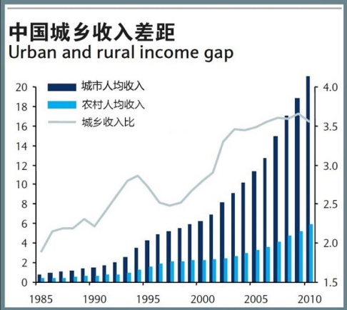
可持续消费与生产的基本理念
Principles of Sustainable Consumption and Production
可持续消费是绿色发展战略的核心组成部分，与中国生态文明建设密切相关，对中国城镇化进程至关重要。
Sustainable Consumption is a central component of any Green Development strategy. Furthermore, Sustainable Consumption is closely aligned with China’s unique approach of creating an Ecological Civilisation and is important for China’s on-going urbanisation process.
可持续消费将是解决当前中国城市环境污染的重要组成部分。
Sustainable Consumption will be an important component to finding solutions for the current environmental challenges of China’s cities.
可持续消费也可成为推动解决贫富差距和城乡居民生活水平差异的有效途径。
Sustainable Consumption can be an approach to bridge the gap between the rich and poor and differences in living standards between urban and rural areas.

Slide 8
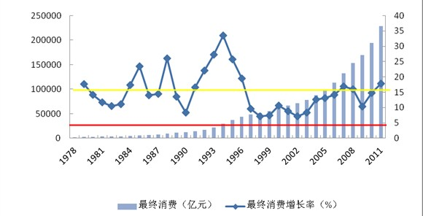
可持续消费与生产的基本理念
Principles of Sustainable Consumption and Production
促进可持续消费：挑战与机遇
Sustainable Consumption: Challenges and Opportunities
1978-2011年中国消费贡献、投资贡献率变化趋势
Contributions to Growth in 1978-2011
1978-2011年中国最终消费支出、增长率示意图
China’s final Consumption and Increasing Rate in 1978-2011
Contribution of Consumption
Contribution of Investment
Final consumption (0.1 billion Yuan)
Final increasing rate (%)
资料来源：中国统计年鉴2012
Source: China Statistical Yearbook 2012
资料来源：中国统计年鉴2012
Source: China Statistical Yearbook 2012

Slide 9
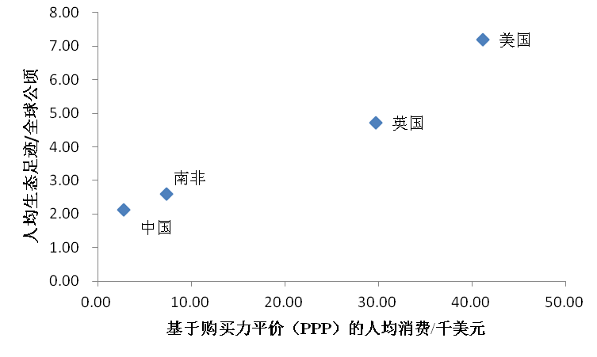
可持续消费与生产的基本理念
Principles of Sustainable Consumption and Production
挑战与机遇 Challenges and Opportunities
Per capita ecological footprint/global hectare
USA
UK
South Africa
China
Purchasing Point Parity (PPP) Based Per Capita Consumption/thousand USD
中国、美国、英国、南非的基于购买力平价(PPP)的人均消费与生态足迹的关系
（数据来源：中国科学院地理科学与资源研究所&世界银行WDI数据库，2008）
Relation between PPP Based Per Capita Consumption and Ecological Footprints in China, USA, UK, and South Africa (Sources: CAS Institute of Geographic Sciences and Natural Resources Research & World Bank WDI Database, 2008)

Slide 10
可持续消费与生产的基本理念
Principles of Sustainable Consumption and Production
挑战与机遇 Challenges and Opportunities
中国现阶段经济及消费模式：
高消耗、低效益
China’s economy and its innate consumption patterns:
high energy consumption and low benefit.
文化娱乐、教育及其他服务类的比重较低
Low proportion of entertainment, education, and other service consumption.
转型升级，提升资源效率带来的经济效益
Transition and upgrading to improve
cost-benefit brought by resource consumption.
服务业占GDP比重不到50%、生态足迹的经济效益偏低
Proportion of service industry in GDP less than 50%, low benefits for the corresponding ecological footprint.

Slide 11
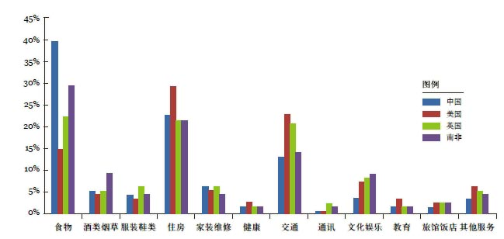
可持续消费与生产的基本理念
Principles of Sustainable Consumption and Production
挑战与机遇 Challenges and Opportunities
住房、交通、食品等领域资源环境压力大，生态足迹较高，应优先推动可持续消费.
Housing, mobility, and food are the major domains that generate high ecological footprint and impose large pressures on environment & resources, and should be priority domains to boost sustainable consumption.
中国、美国、英国、南非的家庭消费足迹分类（数据来源：全球足迹网络，2011）
Ecological Footprint of Different Types of Household Consumption in China, USA, UK,
and South Africa (Source: Global Footprint Network, 2011)
45%
40%
35%
30%
25%
20%
15%
10%
5%
0%
图例 Legend
中国China
美国USA
英国UK
南非South Africa
食物
Food
烟草消费
Wines and Tobacco
服装鞋类
Clothes and Shoes
住房
Housing
家装维修
House Decoration
and Maintenance
健康
Health Care
交通
Transportation
t通讯
Communications
文化娱乐
Cultural and Entertainment Services
教育
Education
旅馆饭店
Hotel and Restaurant Services
其他服务
Other Services

Slide 12
可持续消费与生产的基本理念
Principles of Sustainable Consumption and Production
挑战与机遇 Challenges and Opportunities
在住房这一需求领域开展可持续消费，可以减少中国城市建设领域对初级金属、钢材、木材和混凝土需求增长。
Sustainable Consumption in the building of new housing can reduce China’s growing need for primary metals, steel, timber and concrete in urban construction.
机遇
Opportunities
将可持续消费模式应用于交通领域，可以有效减少油耗，减少大气污染物排放。
Promoting SC in transportation patterns, could substantially reduce China’s oil consumption and air pollution.
中国重视家庭用品和其能源与材料使用效率，有利于粮食安全与食品安全。
China’s emphasis on household goods and their energy and material efficiency is already one of the best efforts at providing better product choices to consumers.

Slide 13
中国可持续消费的政策与趋势
Sustainable Consumption Policies and Trends in China
中国可持续消费现状：
Status Quo of Sustainable Consumption in China:
中国的人均消费水平在几个经济大国中是最低的
Consumption per capita in China is the lowest among large economic powers.
投资增长率过高，远远超出国内的消费水平。
Domestic consumption could not keep up the very high growth rates in investments.

Slide 14
中国可持续消费的政策与趋势
Sustainable Consumption Policies and Trends in China
中国可持续消费现状：
Status Quo of Sustainable Consumption in China:
既有进展又受制约，消费不足与消费浪费并存
Progress and constraints, consumption insufficiency and extravagance co-existing.
消费增长率低于GDP增长率、高储蓄率、分配不公等;
Consumption increase rate < GDP growth rate; high savings rate; unfair distribution of income.
可持续消费能力提升，消费环境改善，国民意识开始形成，消费对象丰富。
Sustainable consumption capability increases; sustainable consumption environment improves; national awareness of sustainable consumption is forming; goods for sustainable consumption become enriched.

Slide 15
中国可持续消费的政策与趋势
Sustainable Consumption Policies and Trends in China
中国可持续消费现状：
Status Quo of Sustainable Consumption in China:
有利于新能源发展的财政补贴政策
The financial subsidy policy for new energy
节能服务行业的投资政策
The investment policy for energy-saving service industries
建立可再生能源的发展基金
The establishment of a fund for the development of renewable energies
替代燃料汽车（主要是电力方面）的补贴政策
The provision of subsidies for alternative fuel (mainly electric) automobiles
对乘用车税率结构的调整
The adjustment of taxes for passenger cars

Slide 16
中国可持续消费的政策与趋势
Sustainable Consumption Policies and Trends in China
中国可持续消费政策的缺失和差距
Deficiencies of existing Policies promoting Sustainable Consumption in China
1
2
未纳入国家发展计划和重要法律
Sustainable Consumption has not been integrated into national development plans and major laws.
未系统地列入国家政策框架内
Sustainable Consumption has not been systematically instituted into national policy frameworks.
4
3
缺乏有效的落实体制
Sustainable Consumption policy lacks effective enforcement.
未充分考虑中国区域经济发展差异
Existing policies related to Sustainable Consumption do not sufficiently consider differences in China’s regional economic development.
5
缺乏可持续消费指标体系
Lack of Sustainable Consumption index.

Slide 17
中国可持续消费的政策与趋势
Sustainable Consumption Policies and Trends in China
中国可持续消费政策的缺失和差距
Deficiencies of existing Policies promoting Sustainable Consumption in China
中国还没有能够大力
推动可持续消费的系统化
政策措施
A systematic policy approach that strongly pushes for SC could not be identified.
低碳城镇化 Low-carbon urbanization
家庭与个人消费行为改变 Changes in household and individual consumer behaviour
创新型商业模式 Innovative business models
高品质的绿色产品 High-quality green products
国际竞争力增强 Enhanced international competitiveness
社会发展机会增多 Enhanced opportunities for social development among others
将可持续消费作为优先政策可以形成众多机会
A number of opportunities for China that would result from making SC a policy priority.

Slide 18
Sustainable Consumption and Production
可持续消费与生产
Integrate Sustainable Consumption Into National Political And Social-Economic Development Frameworks
建议1 ：将可持续消费纳入国家政治与社会经济发展框架
Resource extraction
TEXT
TEXT
TEXT
TEXT
Transport
Manufac-turing
Rec. 1
建议一
Production
生产
Consumption
消费
Rec. 2
建议二
Retail
Enable Institutional Innovations For SC In The Administrative System And Society
在执政体系内与全社会中推动可持续消费制度创新
Use-phase
Initiate Multi-Stakeholder Partnerships For SC建立多利益相关方参与的可持续消费合作关系
End-of-life
Rec. 3
建议三

Slide 19
Strategic Recommendation No 1
战略建议一
RECOMMENDATION 1: Integrate Sustainable Consumption into National Political and Social-Economic Development Frameworks
建议1 ：将可持续消费纳入国家政治与经济社会发展框架
TEXT
TEXT
TEXT
TEXT
1.1 Feature Sustainable Consumption prominently in the 13th Five-Year Plan
在“十三五规划”中着重强调可持续消费
1.2 Integrate Sustainable Consumption into existing legislation
将可持续消费纳入现行法律法规
1.3 Adjust existing economic instruments and specific policies to support implementation of laws and regulations
调整现有的经济手段和具体政策，促进法律和法规的实施
1.4 Integrate SC into China’s low-carbon urban development strategy
将可持续消费纳入中国的低碳城市发展战略
1.5 Develop a national SC Roadmap and SC Action Plan to support implementation
制定国家可持续消费路线图与《可持续消费行动计划》以辅助实施

Slide 20
Strategic Recommendation No 1
战略建议一
International experiences 国际经验:
RECOMMENDATION 1: Integrate Sustainable Consumption into National Political and Social-Economic Development Frameworks
建议1 ：将可持续消费纳入国家政治与社会经济发展框架
SCP Action Plans as macro-level framework for SC (e.g. EU and Brazil) 可持续消费和生产行动计划作为可持续消费的宏观框架（欧盟、巴西）
Green Public Procurement Law (Japan) 绿色公共采购法（日本）
National EU Member States policies 欧盟成员国的相关政策
TEXT
TEXT
TEXT
TEXT
Whom to involve? 参与方
State Council 国务院
Various ministries and agencies 各部委和机构
Ministry of Environmental Protection环保部
Suggested Implementation Timeline: 建议实施时间
Legislation updates
立法修订
SC in 13th Five Year Plan
纳入十三五规划
SC Law
可持续
消费法
2015
2020

Slide 21
Strategic Recommendation No 2
战略建议二
RECOMMENDATION 2: Enable institutional Innovations for SC in the administrative System and Society
建议2：在执政体系内与全社会中推动可持续消费制度创新
TEXT
TEXT
TEXT
TEXT
2.1 Set up an inter-ministerial cooperation mechanism on SC and Green Development
建立可持续消费与绿色发展部际间协调合作机制
2.2 Enhance credibility and independence of China’s product certification
systems
提高中国产品认证体系的公信力与独立性
2.3 Initiate local pilot projects for Sustainable Consumption
开展可持续消费地方试点项目
2.4 Develop and apply SC indicator systems
建立并应用可持续消费指标体系

Slide 22
Strategic Recommendation No 2
战略建议二
International experiences 国际经验:
EU Ecolabel, Germany’s “Blue Angel”, Danish Eco-food label 欧盟生态标识，德国蓝色天使，丹麦生态食品标签
One Planet Living Communities in UK 英国一个地球生活社区
SC Indicators of the European Environment Agency 欧洲环境署的可持续消费指标
RECOMMENDATION 2: Enable institutional Innovations for SC in the administrative System and Society
建议2：在执政体系内与全社会中推动可持续消费制度创新
TEXT
TEXT
TEXT
TEXT
Whom to involve? 参与方
Various ministries and agencies
各部委和机构
National and int. product certification bodies 国内外产品认证机构
Local governments & communities地方政府和社区
National and int. research institutions 国内外研究机构
Suggested Implementation Timeline 建议实施时间
Main
streaming SC indicators
主导可持续消费指标
Local community pilots 地方社区示范
Enhancing product certification
提升产品认证
2015
2020

Slide 23
Strategic Recommendation No 3
战略建议三
RECOMMENDATION 3: Initiate Multi-Stakeholder Partnerships for SC
建议3：建立多利益相关方参与的可持续消费合作关系
TEXT
TEXT
TEXT
TEXT
3.1 Build capacity of local government to establish SC practices
加强地方政府能力建设，推动可持续消费实践
3.2 Engage the private sector (particularly retailers and financial institutions)
充分利用私营部门的力量（特别是零售商和金融机构）
3.3 Enable civil society initiatives and public participation
支持民间行动，促进公众参与
3.4 Collaborate with the international community
推动国际合作

Slide 24
Strategic Recommendation No 3
战略建议三
International experiences: 国际经验
RECOMMENDATION 3: Initiate Multi-Stakeholder Partnerships For SC
建议3：建立多利益相关方参与的可持续消费合作关系
EU Retailer Forum & Food Roundtable 欧洲零售商和食品圆桌会议
Independent consumer advisory centres (Germany) 独立的消费者咨询中心（德国）
Community initiatives & online sharing platforms (US) 社区行动和在线合作消费平台
TEXT
TEXT
TEXT
TEXT
Whom to involve? 参与方
UNEP and int. organisations 联合国环境署和其他国际机构
Local government (procurement agencies and national consumer associations) 地方政府（采购机构和消费者协会）
Private sector (retailers and financial institutions) 私营行业（零售商和金融机构）
Civil society organisations 公民社会组织
Suggested implementation Timeline 建议实施时间
UNEP 10 YFP
UNEP10
年框架计划
Stakeholder partnerships利益相关方合作行动
New product information systems 新产品信息系统
2015
2020

Slide 25
Sustainable Consumption & Low-carbon Urbanization
可持续与消费与低碳城市化
Adoption of SC indicators for assessing city performance
采用SC指标评价城市绩效
Green public procurement by local government
地方政府绿色采购
Local Government level
地方政府
Energy efficiency in industry and power plants 提高工业和电业系统的能效
Emission trading system pilots
碳排放交易试点
Sustainable Consumption in cities
城市可持续消费
Retailer initiatives promoting green products
零售商绿色产品推广行动
Low-carbon cities
低碳城市
Green bank loans for energy efficient housing 为能效建筑和设施提供 绿色银行贷款
Business level
工商业
Use of public transport
公共交通的利用
Renewable energy technologies (solar water heaters) 可再生能源技术 （太阳能热水）
Civil society level
公民社会
Community-based consumer advisory centres
基于社区的消费者咨询中心
Education campaigns in schools and communities社区和学校教育行动

Slide 26
Recommendations and Stakeholder Responsibilities
政策建议和利益相关方的责任
SC Legislation 立法
SC in 13th Five-Year Plan 十三.五规划
SC Roadmap and SC Action Plan 路线图和行动计划
Economic instruments & policies 经济措施和政策
SC political framework 可持续消费政治框架
TEXT
TEXT
TEXT
TEXT
Business
工商业
(Local) Gov. 地方政府
Consumers 消费者
Civil Society 公民社会
Local pilot projects for SC and low-carbon cities
可持续消费地方示范项目和低碳城市
Green public procurement
绿色公共采购
Consumer advisory centres
消费者咨询中心
Products standards and certification 产品标准和认证
Independent product testing
独立的产品比较试验
Green loans and credits for green buildings
为绿色建筑提供绿色信贷
Sustainable Retail Forum
可持续零售商论坛

Slide 27
Let’s join hands to create a brilliant future
in joint effort!
携手合作，共创辉煌!
Image source: www.flickr.com

Slide 28
Thank You !
谢谢大家！

