Slide 1
如何平衡气候变化与经济增长
BREAKING THE LINKS
BETWEEN GROWTH AND CLIMATE CHANGE
安德鲁斯蒂尔博士 主席兼执行总裁
Andrew Steer President & CEO
中国环境与发展国际合作委员会年会 | 北京 CCICED Annual Meeting | Beijing, China
2013年11月14日 November 14, 2013

Slide 2
六大全球挑战
SIX GLOBAL CHALLENGES
森林
粮食
水资源
气候变化
能源
城市与交通
Notes:
Who we are
Founded in 1982
A “think and do” tank
6 global challenges

Slide 3
我们的工作方法
WRI’S APPROACH
量化
Count It
改变
Change It
推广
Scale It
以成效至上的数据分析和工具
Managing for Results
Data, Analysis & Tools
开展一些列活动、对模式进行探索和检验、产生实质影响
Convening, Testing & Influencing
提出系统性的建议并进行有效传播和沟通
Systemic Adoption
& Communications
Notes:
Over the years, we have refined and sharpened how we define the different elements of our approach. In this slide, you see the specific questions we ask today of each WRI project – these are the questions we would expect answered in a project plan or strategy.
What we do: count it, change it, scale it

Slide 4
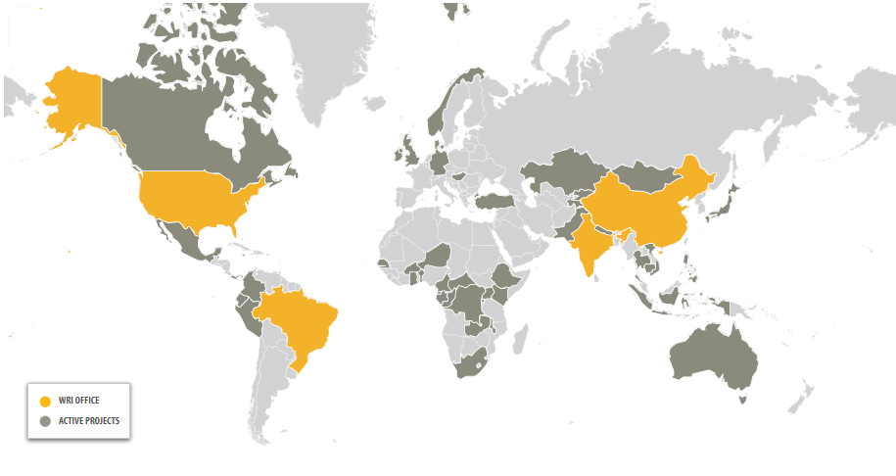
建立全球工作网络
WRI’s COUNTRY NETWORK
Notes:
China office -- Opened in 2008
Number of staff – now 22 full time, and will possibly grow to 50 by 2017

Slide 5
资源挑战随着经济增长而更加严峻
AS CHINA GROWS, SO DO ITS RESOURCE CHALLENGES…
同时，也是绿色增长的机遇…
BUT SO DO OPPORTUNITIES FOR GREEN GROWTH.

Slide 6
更有力的环境政策会阻碍还是会促进经济发展？ Will stronger environmental policies hurt or help the economy?

Slide 7
1. 双赢的机会远大于我们的估计 1. Win-Win Opportunities are bigger than we thought.

Slide 8
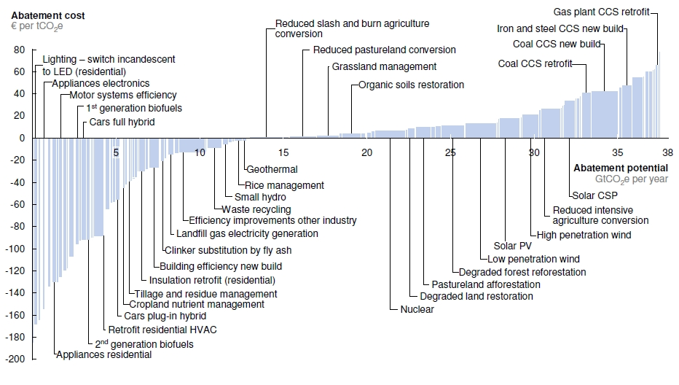
资源效率：双赢
Resource Efficiency: Win-Wins
(McKinsey 2010)

Slide 9
巢湖流域总氮PROA分析
PROA Analysis of Chao Lake
(Draft. Not for distribution)
730
1500
1600
1200
2800
1300
810
4200
2000

Slide 10
2. 科技变革比我们想象的更快！ 2. Technology Change can be induced more quickly than we thought!

Slide 11
技术变革
Directed Technical Change
Porter and van der Linde (1995)…Acemoglu and others (2011)
… which leads to increased competitiveness
… 从而提高市场竞争力.
Policy promotes innovation
政策促进创新

Slide 12
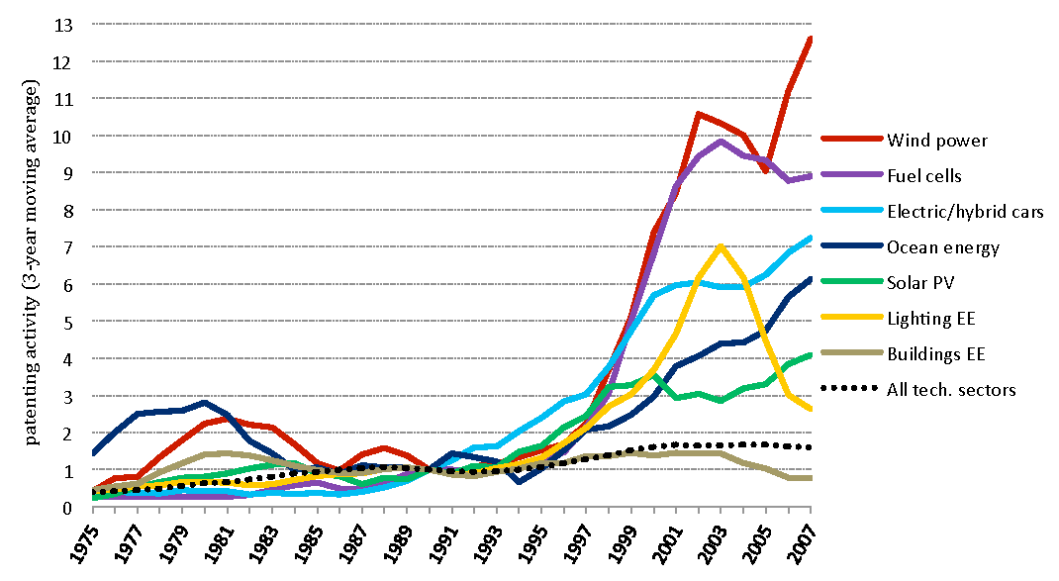
技术变革
Directed Technical Change
Index of innovation in climate change mitigation technologies (1990 = 1)
OECD 2010

Slide 13
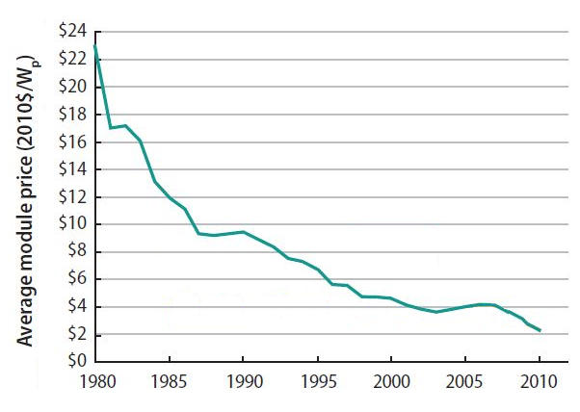
光伏成本的下降
Falling Costs in Solar PV
(US Department of Energy, 2011)
Notes:
US DOE, 2010 Solar Technologies Market Report, 2011, p. 60 (Figure 3.7)
Figure 3.7 shows the range of average global PV module selling prices at the factory gate (i.e., prices do not include charges such as delivery and subsequent taxes), as obtained from sample market transactions for small-quantity, mid-range, and large-quantity buyers.
W_{p} refers to watt-peak, which is a measure of the nominal power of a PV device. It is the standardized number in the industry on which prices, sales and growth numbers are based.

Slide 14
可再生能源装机容量
RENEWABLE ENERGY INSTALLED CAPACITY IN CHINA
China
U.S.
Germany
Spain
Italy
Japan
India
France
Brazil
(Pew 2012)
Notes:
China continues to make large investments in renewable energy, with over 80% more investment than the U.S. last year. In fact, China invested $65 billion in renewable energy in 2012, more than any other country. China remains the country with the world’s most installed wind capacity, and it is neck and neck with the U.S. in terms of installed solar PV capacity.
http://www.pewenvironment.org/uploadedFiles/PEG/Publications/Report/FINAL_forweb_WhoIsWinningTheCleanEnergyRace-REPORT-2012.pdf
(figures for 2011 – look for update)
China has led global investment since 2009 (Pew), accounting for a fifth of global investment.
Chart for 2011:
http://fs-unep-centre.org/sites/default/files/publications/globaltrendsreport2012final.pdf
Chart for 2009-2011:
http://unfccc.int/files/cooperation_support/financial_mechanism/long-term_finance/application/pdf/usher_9_july_2012.pdf
(couldn’t find three-year data for Germany, Italy, and rest)
Other:
E&Y says China is the most renewable energy-friendly country in the world.
http://www.ey.com/GL/en/Industries/Cleantech/Renewable-energy-country-attractiveness-indices_November-2012
Global wind power capacity has grown at an average of 25 percent per year over year the past five years, and solar PV has grown at a rate of 50 percent.
http://www.iea.org/aboutus/faqs/renewableenergy/
The global market for renewables will be worth trillions over the coming decades. According to the IEA, 60% of the new installed capacity between now and 2035 will be from renewables.
http://www.worldenergyoutlook.org/media/weowebsite/2012/factsheets.pdf, p.3
China has led since 2009 -- http://green.blogs.nytimes.com/2010/03/29/china-leads-in-renewable-investments/, citing Pew

Slide 15
RENEWABLE ENERGY | INSTALLED WIND CAPACITY
可再生能源 | 风电装机容量
Source: BP
Notes:
Wind Power: China ranks 1st in the world in installed wind power capacity, with about 75 GW. China is also the world’s fastest-growing installer of wind, and it aims to have 100 GW of wind installed by 2015.
Source: http://www.pewenvironment.org/uploadedFiles/PEG/Publications/Report/FINAL_forweb_WhoIsWinningTheCleanEnergyRace-REPORT-2012.pdf

Slide 16
两大挑战： （i）城镇化 （ii）摆脱“煤炭依赖” Two Crucial Test Cases for these hypotheses: (i) Urbanization (ii) The transition from Coal

Slide 17
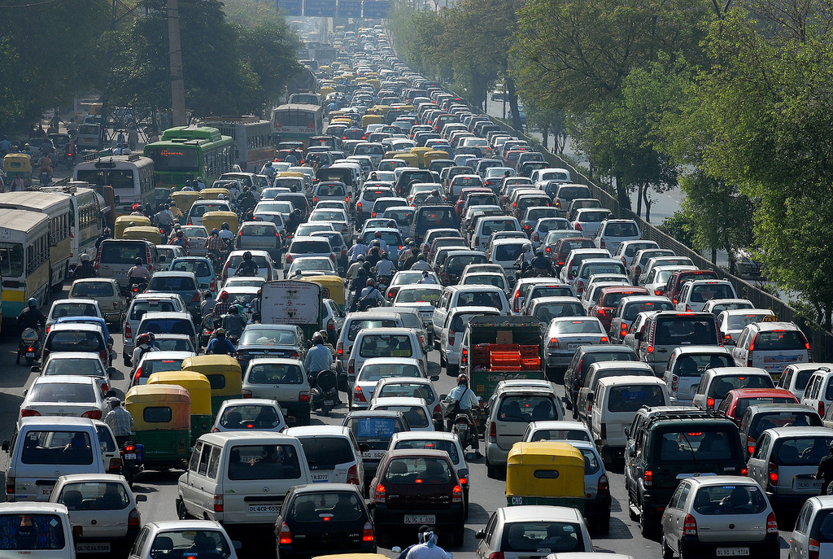
中国面临的挑战
CHINA’S COMING CHALLENGES
可持续城镇化
URBANIZATION TOWARD SUSTAINABLITY
Notes:
Photo: World’s largest traffic jam
Photo credit: http://s1.cdn.autoevolution.com/images/news/how-to-avoid-traffic-jams-35319_2.jpg

Slide 18
前所未有的城镇化进程
CHINESE URBANIZATION UNPRECEDENTED
530
Million in 2005
78%
930
urban contribution to GDP
Million people living in cities in 2025
INDIAN CITIES SLOWER
315
39%
Million in 2008
Urban contribution to GDP
530
Million in 2025
(McKinsey Global Institute 2012, )
Notes:
China:
China has 710 cities with populations over 200,000. It’s cities are expected to add another 400 million people between 2005 and 2025.
India:
India’s cities are expected to contribute 50% of India’s GDP growth to 2025 but are currently not as large as those in China.
NOTE: growth projections for Indian cities are from 2010 and assumed an 8% growth rate over coming decades – now more like 6% projected
Source for GDP contributions: Dobbs et al., Urban World: Rise of the Consuming Class, McKinsey Global Institute, June 2012.
Source for Population projections: Sankhe et al., India’s Urban Awakening: Building Inclusive Cities, sustainable urban growth. McKinsey Global institute, April 2010.

Slide 19
城市是生态系统的一个熵增系统 CITY AS A SYSTEM OF ENTROPY
提高效率
Improve efficiency
& consumption
自然资源& 环境容量Natural resource & environment capacity
生产&消费
Production &consumption
废弃物&污染
Wastes &pollutants...
回收和控制废弃物&减少污染
Recycle and control wastes & pollutants

Slide 20
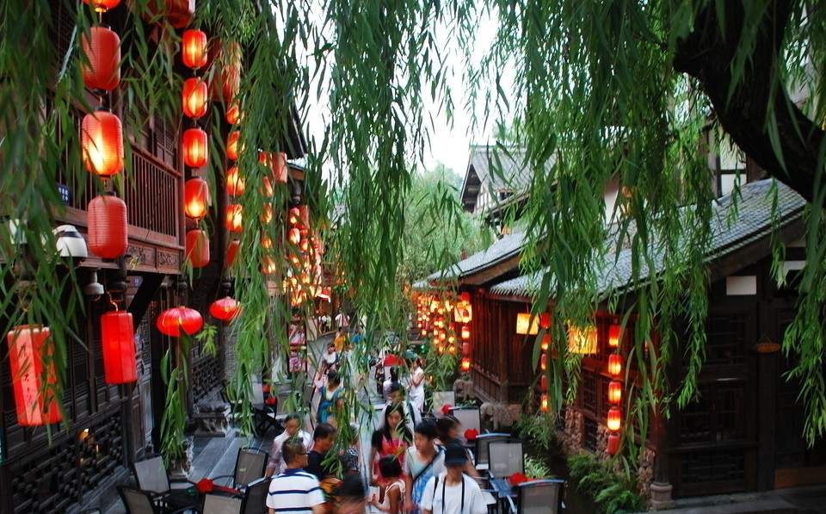
创建低碳城市典范
CREATING LOW CARBON CITY MODELS
CHENGDU,
中国成都
QINGDAO
青岛
Notes:
-WRI has worked with the NDRC (National Development and Reform Commission) and Caterpillar Foundation on a five-year program to develop low-carbon city models in Chengdu and Qingdao.
-The aim has been for cities to demonstrate how they can use "avoid, shift and improve" strategies to increase energy efficiency, curb greenhouse gas emissions, and improve water quality, urban mobility and land use.
-The goal has been to create "blueprints" - low-carbon plans for environmentally sustainable and livable cities - to help implement large-scale, high-impact projects. WRI will then conduct a targeted outreach effort to disseminate lessons learned to other growing cities to help them adapt key elements to their own conditions.
**Discuss how this fits into “Count it, change it, scale it”
Photo credit: remkotanis/Flickr

Slide 21
成都市低碳发展规划蓝图研究
Chengdu LC blueprint study
设定和分解目标Target Setting & Allocation
情景分析
Scenario Development
技术路线图Technology Roadmap
规划蓝图Blueprints
规划蓝图的编制和实施过程Blueprint preparation and implementation process
投资分析Investment analysis
基准线
Baseline
行动计划Action
Plan
跟踪评估Performance tracking
实施Implemen-tation
示范项目Demonstration projects
Partner cities
Government buy-in
Blueprint
Demo projects
Scaling up
Toolkits

Slide 22
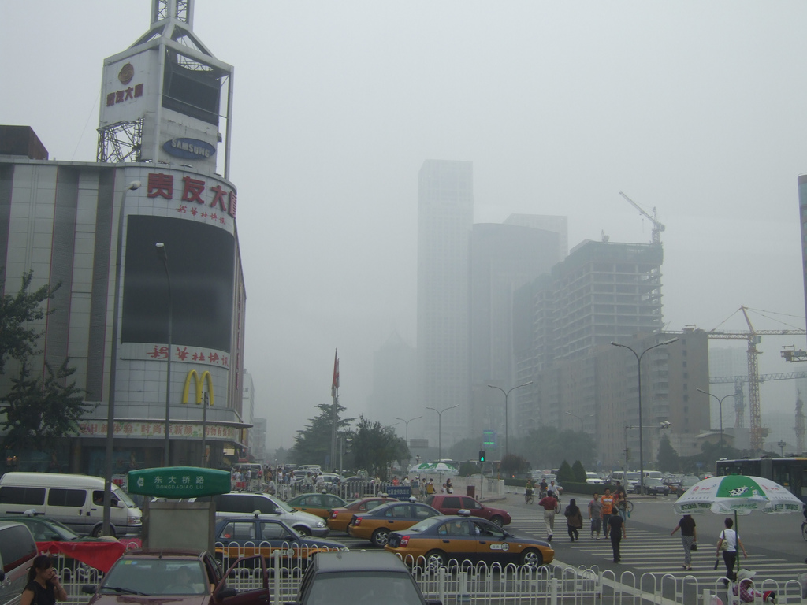
进展
SIGNS OF PROGRESS
2013年9月：
中国政府颁布《大气污染防治行动计划》
September 2013:
Government of China announced national plan to curb air pollution
Notes:
The Chinese government announced a plan in September to curb air pollution across the nation (set some limits on burning coal and took high-polluting vehicles off the roads).

Slide 23
2.降低煤炭使用
2. SHIFTING AWAY FROM COAL

Slide 24
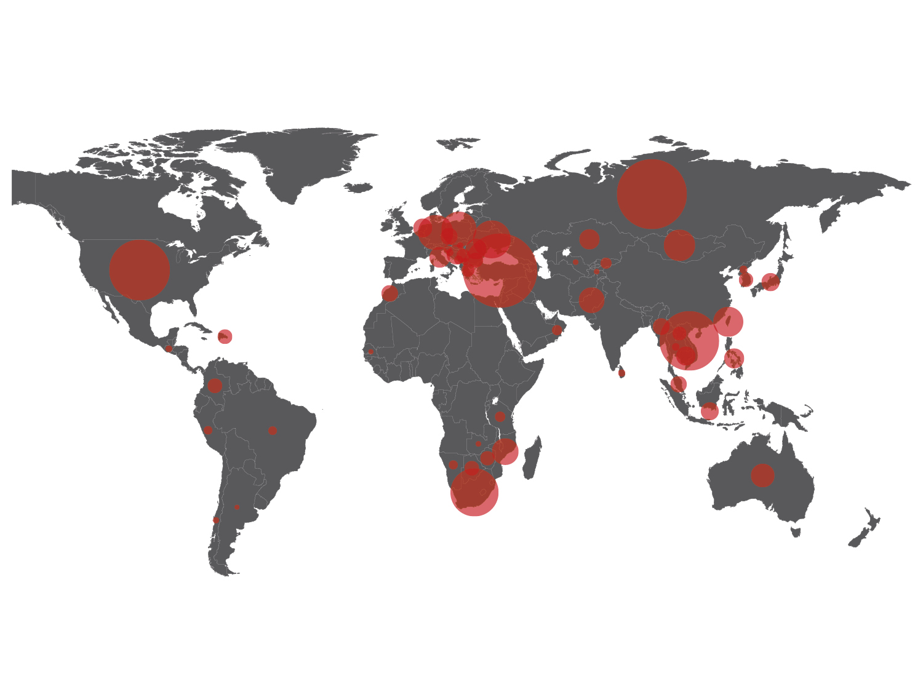
计划新增煤电产能
PROPOSED NEW COAL POWER CAPACITY
(WRI 2012)
Notes:
-As of July 2012 -- China’s government planned 363 coal-fired power plants for construction across China, with a combined generating capacity exceeding 557 GW (installed capacity at the end of 2012 was 758 GW). This amounts to an almost 75 percent increase in coal-fired generating capacity.

Slide 25
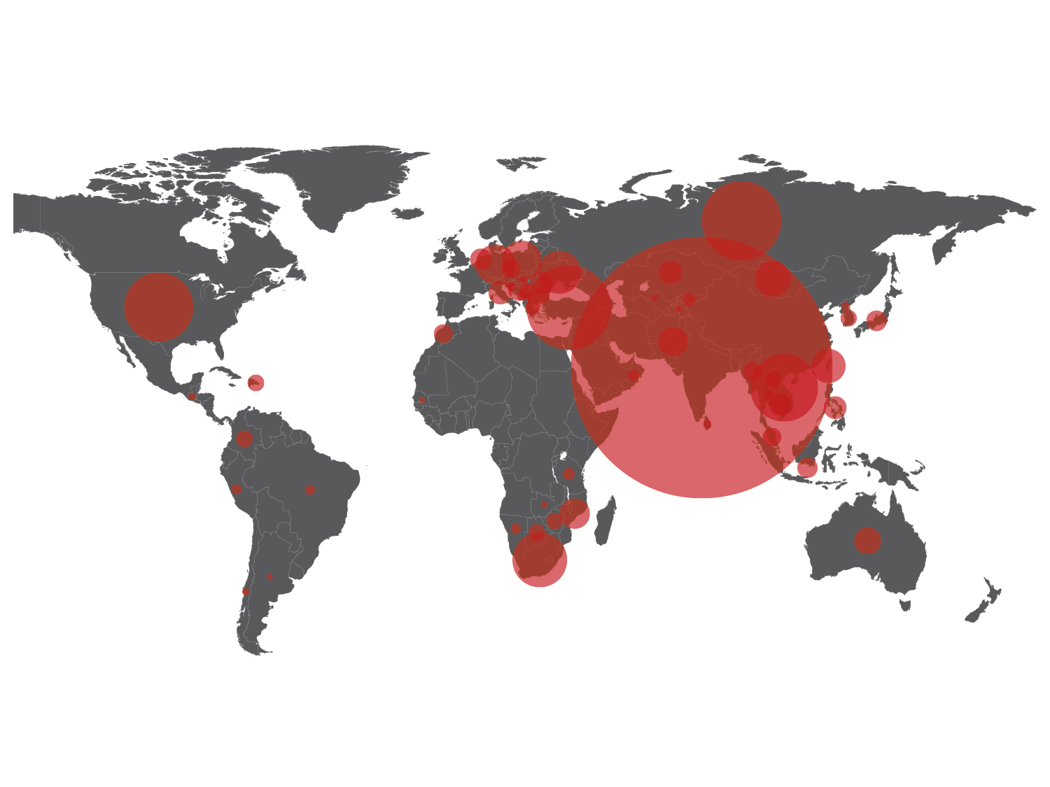
计划新增煤电产能
PROPOSED NEW COAL POWER CAPACITY
印度INDIA
(WRI 2012)
Notes:
This is especially the case in India…

Slide 26
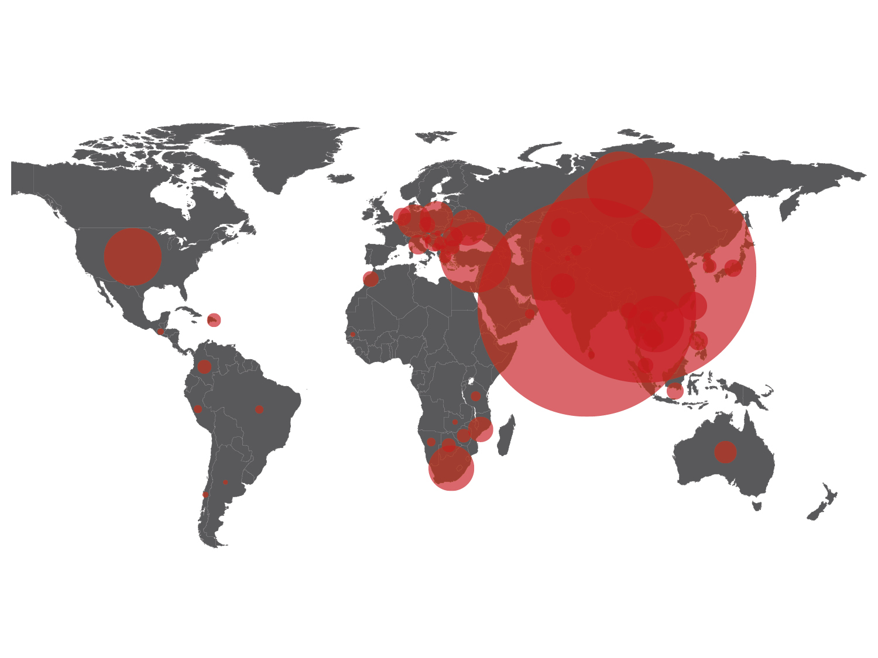
计划新增煤电产能
PROPOSED NEW COAL POWER CAPACITY
中国
CHINA
印度INDIA
(WRI 2012)
Notes:
And China.

Slide 27
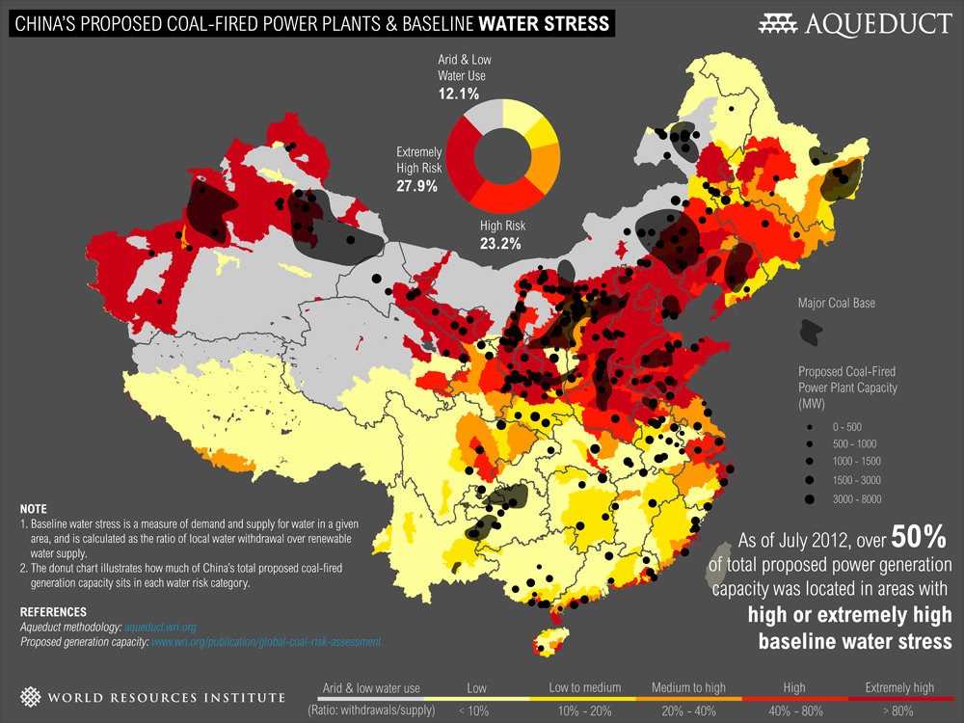
51%
计划新建煤电厂在极度缺水地区
Proposed coal power capacity in areas of high or extremely high water stress
(Pew 2012)
Notes:
Dots: Proposed power plants
Grey areas: Coal basins
Dot size correlates with power plant generation capacity.

Slide 28
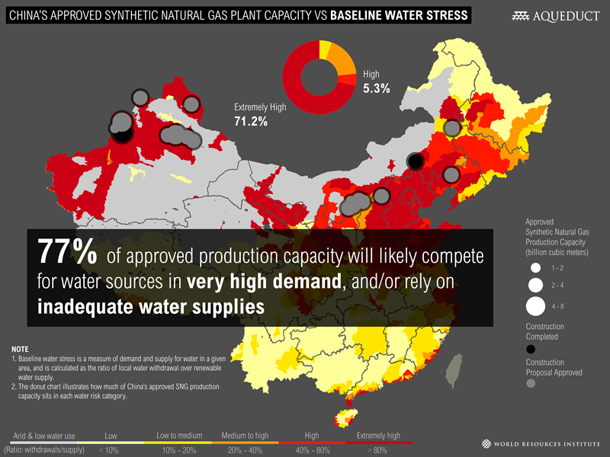
PROVIDING TOOLS FOR DECISION-MAKING
MAPPING WATER RISK WITH AQUEDUCT
77% 批准新建的煤制天然气产能分布在极度缺水地区。很可能与当地其他用水形成竞争。
(WRI 2013)
Notes:
-We found that 51 percent of China’s new coal-fired power plants would be built in areas of high or extremely high water stress.
-This finding is especially troubling because coal-related industries—mining production, coal-to-chemical, and power generation—are extremely water-intensive. If all of the proposed plants are built, the coal industry–including mining, chemical production, and power generation–could withdraw as much as 10 billion cubic meters of water annually by 2015. That’s more than one-quarter of the water available for withdrawal every year from the Yellow River.

Slide 29
中国的环境退化损失严重
CHINA’S ENVIRONMENTAL DEGRADATION IS VERY COSTLY
9.2% OF GDP
(World Bank reports, 2005-2012)
Notes:
http://www.eia.gov/coal/review/coal_consumption.cfm
and
http://www.eia.gov/coal/review/coal_exports_imports.cfm

Slide 30
有限的资源
LIMITED RESOURCES
全球消耗总量占比
PERCENTAGE OF GLOBAL CONSUMPTION
(World Bank reports, 2005-2012)
Notes:
GDP data for 2011: http://databank.worldbank.org/databank/download/GDP.pdf
Co2 Data for 2011: http://edgar.jrc.ec.europa.eu/overview.php?v=CO2ts1990-2011
Steel, coal, timber, palm oil, fish: Chatham House Resources Futures http://www.resourcesfutures.org/#!/more-more-and-more
Ranking?

Slide 31
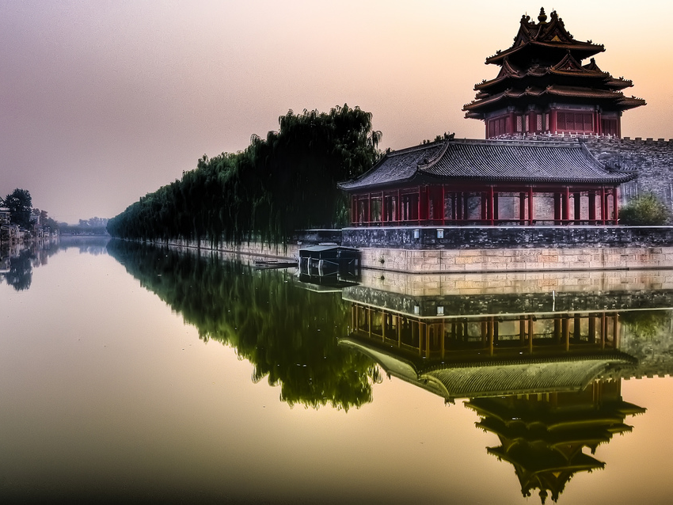
谢谢 Thank you！ www.wri.org
安德鲁斯蒂尔博士 主席兼执行总裁 Andrew Steer, President & CEO
中国环境与发展国际合作委员会年会 | 北京 CCICED Annual Meeting | Beijing, China
2013年11月14日 November 14, 2013

