Slide 1
突破资源环境制约，促进可持续发展与社会和谐 Overcoming Resource and Environmental Constraints to the Realization of Sustainable Development and a Harmonious Society
国合会
清华大学 何建坤
Tsinghua University
He Jiankun
2013-11-13

Slide 2
1. 全球可持续发展受到日益强化的资源环境制约，绿色低碳发展已成为世界潮流(1) The resource and environmental constraints on global sustainable development has increasingly been intensified and the green and low carbon development has become a global mainstream(1)
快速增长的矿产资源和化石能源的生产和消费，不仅造成资源短缺，也造成大气质量、水资源、土壤污染等生态环境问题；
The rapid growth in the production and consumption of mineral resources and fossil fuels has brought not only shortage of resources but also the environmental and ecological problems such as the degradation of air quality and water resources and soil pollution;
控制化石能源燃烧的CO₂排放是应对全球气候变化的重要举措。
To control CO₂ emissions from burning fossil fuels is an important measure to address global climate change.
全球实现控制温升不超过2℃目标，必须减少化石能源消费，世界各国都面临排放空间不足的挑战
To achieve the goal 2 ℃ target, all countries need to reduce the use of fossil fuels to overcome the constraint of CO₂ emission.

Slide 3
1. 全球可持续发展受到日益强化的资源环境制约，绿色低碳发展已成为世界潮流(2) The resource and environmental constraints on global sustainable development has increasingly been intensified and the green and low carbon development has become a global mainstream(2)
促进经济社会发展与资源环境相协调已成为当前可持续发展的关键
Coordinating economic and social development with resources and the environment protection has become a key step to sustainable development
“里约+20”峰会主题：在可持续发展和消除贫困框架下发展绿色经济；
"Rio +20" Summit theme : Building a green economy within the framework of sustainable development and poverty alleviation.
全球气候变化“德班平台”谈判，探讨促进全球加大减排力度的制度框架
"Durban Platform" negotiation is to set an institutional framework for intensifying global efforts to mitigate GHG emissions.

Slide 4
2.中国经济社会发展面临日趋强化的资源环境制约，也面临应对气候变化减排CO₂的挑战(1) China’s economic and social development is confronted with increasingly intensified resources and environmental constraints and the challenges associated with addressing climate change. (1)
化石能源消费是造成当前大气污染和雾霾天气的主要原因
The consumption of fossil fuels is the major contributor to China’s current haze and air pollution.
PM_{2.5}中的重金属含量，40-75%来自煤炭燃烧和汽车尾气；
Approximately 40-75% of the heavy metals embodied in PM2.5 particulate comes from coal combustion and vehicle exhaust.
环境污染事件已成为社会不安全因素和群体性事件的重要原因
Environmental pollution incidents has become an important cause of social instability.

Slide 5
2.中国经济社会发展面临日趋强化的资源环境制约，也面临应对气候变化减排CO₂的挑战(2) China’s economic and social development is confronted with increasingly intensified resources and environmental constraints and the challenges associated with addressing climate change. (2)
石油进口依存度达58%，天然气进口比例达29%，2020年将分别达70%和50%
China’s dependency on imported oil and natural gas is 58% 29%, respectively, and could be as high as 70% and 50% by 2020.
煤炭生产量严重超过科学产能，采空区塌陷100万公顷，并造成严重的地下水污染
China’s coal production has been much more than its sustainable capacity, and lead to 1 million hectares of lands subsidized and serious groundwater pollution.
化石能源的CO₂排放约占世界1/4，并呈较快增长趋势
China’s CO₂ emission from fossil fuels accounts for about one fourth of the world total, and demonstrates a rapid growth trend.

Slide 6
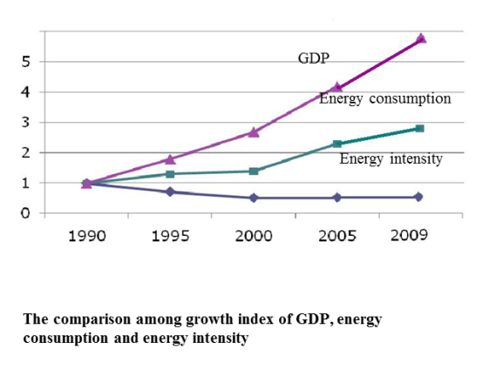
3. 中国节能和减排CO₂取得显著成效，但由于经济快速增长，能源消费和CO₂排放仍呈快速增长趋势
China has made great achievement in energy saving and CO₂ emissions reduction. However, the energy consumption and CO₂ emissions are still on the rise due to the fast economic growth.
从1990-2012年，GDP增长8.6倍，人均GDP由370美元增加到6040美元，单位GDP能源强度下降57%，CO₂强度下降60%。经济发展和节能减排均取得显著成效。
From 1990 to 2012, China’s GDP has experienced a 8.6-fold increase; GDP per capita grew from 370 US dollars to 6,040 US dollars; energy intensity decreased by 57%; and carbon intensity has reduced by 60%. Much has been accomplished in both economic growth and energy saving and emissions reduction.
但同期能源消费总量增3.6倍，2012年能源总消费36.17亿tce，已达世界能源消费量的20%，CO₂排放总量占世界近1/4。2005-2012年新增CO₂排放占世界增量的约60%。
During the same period of time, the total amount of energy consumption increased by 3.6 times, making up for 20% of the world energy consumption by reaching 3.6 billion tce. In 2012, CO₂ emissions accounted for approximately one quarter of the world total emissions; the increased emissions from 2005 to 2012 made up for nearly 60% of the total increase all over the world.

Slide 7
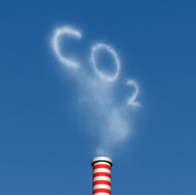
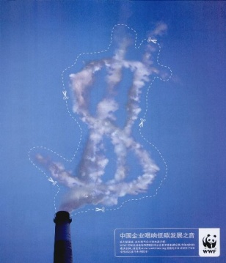
4. 中国大力推广先进节能技术，能效迅速提高，但单位GDP能耗仍处于较高水平(1)
Energy efficiency has been improved rapidly as China has made great efforts to promote the advanced energy saving technologies; yet energy intensity still remains high(1)
“十一五”期间，淘汰落后产能，炼铁1.1亿吨，炼钢0.6亿吨，水泥3.3亿吨，火电机组7200多万千万。钢、水泥、原铝单位产品能耗分别下降12.5%,12.0%和15.2%，煤电站供电煤耗达335gce/kwh，效率已达世界先进水平。
During the 11th Five-Year Plan period, substantial low energy efficient production capacities were phased out by the Government, including 110 million tons of iron-refining, 60 million tons of steel-refining, 330 million tons of cement, and more than 72 GW of thermal power. The energy use per unit of steel, cement and primary aluminum decreased by 12.5%, 12.0% and 15.2% respectively. The energy use of electricity generation in coal-fired plants reached 335 gce/kWh, which was close to the world top level.

Slide 8
4. 中国大力推广先进节能技术，能效迅速提高，但单位GDP能耗仍处于较高水平(2)
Energy efficiency has been improved rapidly as China has made great efforts to promote the advanced energy saving technologies; yet energy intensity still remains high. (2)
2005-2010年，单位GDP能耗下降19.1%，年均下降4.2%。远超过发达国家水平。
From 2005 to 2010, China’s energy intensity decreased by 19.1% with an annual decrease rate of 4.2%, raced far ahead of developed countries.
单位GDP能耗仍为世界平均水平2倍，美国2.5倍，日本4.3倍。主要是重化工业产业特征和产品价值链低等结构性因素所致。
China’s energy intensity is still twice of the world average, 2.5 times of the US and 4.3 times of Japan largely due to the high contributions of heavy chemical and low value-added industries to the economy.

Slide 9
5. 中国新能源和可再生能源发展迅速，但由于能源消费总量的快速增长，以煤为主的一次能源结构尚未根本性转变(1)
China has experienced fast growth in renewable energy; however, the coal-dominant primary energy supply has not transformed radically due to the fast growth in energy consumption as a whole.(1)
中国可再生能源发展迅速，投资规模、新增容量和增长速度均居世界第一。2012年水电、上网风电、上网光伏发电容量分别达2.5亿千瓦、7600万千瓦、650万千瓦，均达世界前列。核电在建规模3723万千瓦，约为世界40%。
China has experienced fast development in the field of renewable energy and has ranked first in terms of investment scale, the added installed capacity and growth rate. In 2012 the generation capacities of hydro power, grid-connected wind power and grid-connected photovoltaic power reached 250 GW, 76 GW and 6.5 GW, all among the first ranks in the world. The scale of nuclear power in process is 37.23 GW, accounting for nearly 40% of the world total.
2020年，非化石能源比重将由2005年6.8%上升到15%。年供应量超过7亿tce，相当日本能源消费总量。
Non-fossil energies will increase from 6.8% of the primary energy supply in 2005 to 15% in 2020 with an annual added supply over 700 million tce, equivalent to the total amount of energy consumption of Japan.

Slide 10
5. 中国新能源和可再生能源发展迅速，但由于能源消费总量的快速增长，以煤为主的一次能源结构尚未根本性转变(2)
China has experienced fast growth in renewable energy; however, the coal-dominant primary energy supply has not transformed radically due to the fast growth in energy consumption as a whole.(2)
煤炭等化石能源仍快速增长，在一次能源中比例一直在70%左右，2012年煤炭消费36.5亿吨，约占全球45%，2005-2011年新增煤炭消费占世界增量的68%。石油消费增加量占世界增量的47%。
Fossil energy such as coal still grows fast and has been always making up for around 70% of the primary energy. The coal consumption in 2012 was 3.65 billion tons, accounting for 45% of the world total. The increased coal and petroleum consumed from 2005 to 2012 accounted for 68% and 47% of the world respectively.
2010年单位能耗的CO₂排放，中国比世界平均水平高23.8%，比附件I国家高27.6%。
For the year 2010, CO₂ emissions per energy consumption in China was 23.8%, higher than the world average and was 27.6% higher than Annex I countries.

Slide 11
6. 在新的时期和新的形势下，能源与应对气候变化战略需要有更广阔的视角和创新的思路（1） A broad vision and innovative approaches are needed to formulate strategies for energy development and addressing climate change confronting with the new conditions and challenges (1)
节能减排、减缓CO₂排放，既是国内突破资源环境制约，实现可持续发展迫切需求，也是在国际应对气候变化进程中争取主动所必须的战略选择，而传统的能源战略思路难以适应新形势要求。
Energy saving and emissions reductions are the ways to break the resource and environment constraints to realize sustainable development domestically, as well China’s strategic choice to actively participant in global initiatives of addressing climate change.
能源战略要从传统保障供给转变到同时调控需求，控制能源需求总量的过快增长，促进发展方式的转变。强化节能优先，大幅度提高能效。
The traditional energy strategy needs to be shifted from ensuring the supply to coordinating energy supply and demand with an emphasis on controlling the over-speeded growth of the total energy consumption, promoting the transformation of China’s development pattern. Enhancing energy saving and raising energy efficiency should be given priorities.

Slide 12
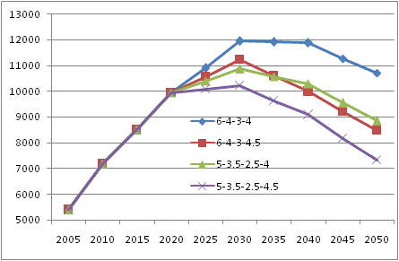
6. 在新的时期和新的形势下，能源与应对气候变化战略需要有更广阔的视角和创新的思路（2） A broad vision and innovative approaches are needed to formulate strategies for energy development and addressing climate change confronting with the new conditions and challenges (2)
能源结构低碳化，实现大比例可再生能源目标，建立以新能源和可再生能源为主体的可持续能源体系。
Substantial efforts need to be taken to decarbonize the energy supply mix, realize the target of large contribution of renewable energies, ultimately establish a sustainable energy system with new and renewable energy playing a major role.
非化石能源比重，2020年将达15%，2030年将达20～25%，2050年将达1/3-1/2。
The contribution of non-fossil energies will be 15% in 2020, 20%～25% in 2030 and 33% to 50% in 2050.

Slide 13
6. 在新的时期和新的形势下，能源与应对气候变化战略需要有更广阔的视角和创新的思路（3） A broad vision and innovative approaches are needed to formulate strategies for energy development and addressing climate change confronting with the new conditions and challenges (3)
在确保安全的基础上，稳步、高效发展核能。
Nuclear energy should be promoted stably and effectively on the basis of safety.
核能将是我国未来可持续能源体系中的重要支柱。
Nuclear energy will be a pillar industry in China’s sustainable energy system in the future.
2050年装机3～4亿千瓦，占一次能源比重10～15%，相当于20亿千瓦光伏电站。替代煤炭10～13亿吨，减排CO₂19～25亿吨。本世纪下半叶核能将是向低碳能源体系过渡的主力能源。
In 2050, the generation capacity will reach 300 to 400 GW, accounting for 10% to 15% of all the primary energy, equivalent to that of 2 TW photovoltaic power and reducing 1.9 to 2.5 billion tons of CO₂ emissions.
核能将对我国2030年左右CO₂排放达到峰值起关键作用。
Nuclear energy plays a key part in ensuring that CO₂ emission peak will be reached around 2030
2030年，核电1.5～2亿千瓦，减排10～13亿tCO₂，其后每年新增1000万千瓦，填补新增能源需求的30～40%。如无核能，峰值年份可能延后10年左右，峰值排放量将增加15～20亿吨。
In 2030, the generation capacity of nuclear energy will be 150 to 200 GW with CO₂ emissions reductions of 1 to 1.3 billion tons. The annual increase from 2030 onwards will be 10 GW, making up for 30% to 40% of all the increased energy demand. Without nuclear energy, the year reaching the emission peak will be delayed about 10 years and the amount will increase by 1.5 to 2 billion tons.

Slide 14
6. 在新的时期和新的形势下，能源与应对气候变化战略需要有更广阔的视角和创新的思路（4） A broad vision and innovative approaches are needed to formulate strategies for energy development and addressing climate change confronting with the new conditions and challenges (4)
核能对我国突破资源环境制约、保障能源安全将发挥不可替代的作用。
Nuclear energy is indispensable for China in terms of breaking the resource and environment constraints and ensuring the energy supply security.
核燃料进口亦视为“准国内资源”，是大国提升能源自给率的重要途径，也是我国替代化石能源进口的重要手段。
The imported nuclear fuel is often regarded as a kind of quasi-domestic resource. Promoting nuclear power is an important approach for China to enhance energy self-sufficiency as well as reduce fossil energy import.
核电对减少SO₂、NOx、粉尘等常规污染物排放有重要作用。
Nuclear energy is of importance in reducing emissions from conventional pollutants such as SO₂, NOx and dust.
核能应成为我国战略必争、有自主知识产权和国际竞争力的高技术产业。
A nuclear energy industry with autonomous intellectual property right and international competitiveness should be pursued and regarded as a strategic industry of China

Slide 15
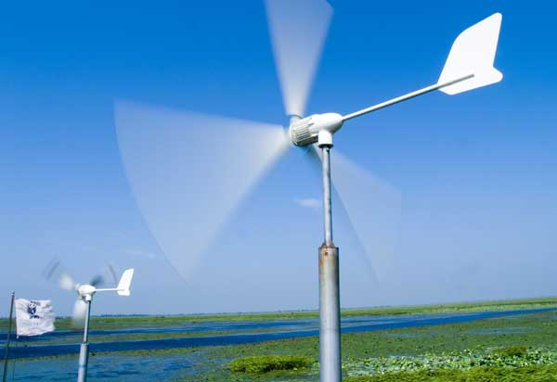
6. 在新的时期和新的形势下，能源与应对气候变化战略需要有更广阔的视角和创新的思路（5） A broad vision and innovative approaches are needed to formulate strategies for energy development and addressing climate change confronting with the new conditions and challenges (5)
加强国内能源资源的开发和科学高效利用，减少对外依赖，保障能源安全。
To promote the sustainable and efficient use of domestic energy resources to ensure energy security
加强常规和非常规天然气的勘探开发，天然气在一次能源比例迅速提升。
To enhance the exploitation and development of conventional and unconventional natural gas to fast raise the natural gas proportion in primary energy supply
发展能源替代技术。
To develop alternative energy technologies
加强国际能源合作，积极参与国际能源安全体系的构建。
To enhance international cooperation in the field of energy and to actively participate in international energy security system construction
能源开发走出去战略。
“Going-out” strategy
能源安全纳入国家整体外交战略。
Energy security as part of the country’s diplomatic strategies

Slide 16
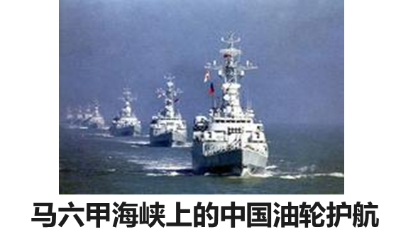
6. 在新的时期和新的形势下，能源与应对气候变化战略需要有更广阔的视角和创新的思路（6） A broad vision and innovative approaches are needed to formulate strategies for energy development and addressing climate change confronting with the new conditions and challenges (6)
加强先进能源技术的研发和产业化，抢占技术制高点，打造低碳竞争能力。
To strengthen R&D and industrialization of advanced energy technologies and to gain the technological low-carbon competitiveness
技术创新是实现低碳能源战略的重要支撑。
Technology innovation is an important basis in carrying out low carbon energy strategy.
低碳技术和产业将是国际技术竞争的前沿和新的经济增长点。实现2℃目标，全球每年附加投资将达1.2万亿美元。
Low-carbon technology and industry will be the cutting edge in international technology competition and a new economic growth point. To achieve the goal of 2 ℃, the global annual investment will be 1.2 trillion US dollars.

Slide 17
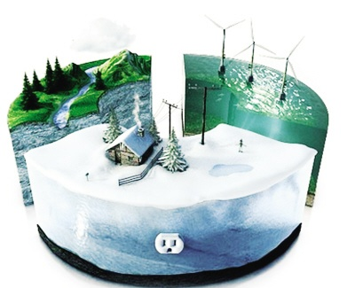
7. 研究并制定积极的CO₂减排目标，作为节约能源、保护环境和应对气候变化的综合对策和关键着力点 (1)
Framing CO₂ emissions reduction goals should be considered as comprehensive and key approaches for energy saving, environment protection and climate change mitigation.(1)
实现单位GDP能源强度和CO₂强度下降约束性目标。
To achieve the goal of reducing energy intensity and CO₂ intensity
2020年单位GDP的CO₂强度比2005年下降40～45%；
CO₂ intensity to decrease by 40% to 45% in 2020 compared to 2005
2015年比2010年单位GDP能源强度下降16%， CO₂强度下降17%；
Energy intensity to decrease by 16% compared to 2010 in 2015 and CO₂ intensity to decrease by 17%
实施能源消费总量的控制目标。
To implement the control plan of total energy consumption
2015年，能源消费总量控制在40亿tce。
The total energy consumption in 2015 to be controlled at 4 billion tce

Slide 18
7. 研究并制定积极的CO₂减排目标，作为节约能源、保护环境和应对气候变化的综合对策和关键着力点 (2)
Framing CO₂ emissions reduction goals should be considered as comprehensive and key approaches for energy saving, environment protection and climate change mitigation.(2)
研究并确立煤炭消费和CO₂排放峰值控制目标。
To study and set the peaks for both coal consumption and CO₂ emissions
CO₂排放峰值出现的时间和峰值排放量取决当前的战略和对策，以及经济发展方式转变的速度和力度。经努力可争取到2030年前后达到峰值水平。
The time and the amount of CO₂ emissions peak is liable to the current strategies, the speed and dynamics of economic development mode transform. Efforts should be made to reach the peak around the year of 2030.
煤炭峰值可出现在CO₂排放峰值之前。消费量峰值可控制在40～45亿吨。
The peak of coal consumption could be ahead of the peak of CO₂ emissions. The peak of coal consumption can be controlled at 4 to 4.5 billion tons.

Slide 19
8. 我国工业化、城市化进程要走上绿色低碳发展路径，首先要促进产业转型，工业部门的能源消费和CO₂排放要率先达到峰值(1)
To achieve the goal of green and low-carbon industrialization and urbanization, the first step is to promote the industry transform and to advance the peak of energy consumption and CO₂ emissions from the industries.(1)
发达国家上世纪70年代工业化后，总能耗基本趋于稳定。OECD的34个国家从1973-2009年，工业终端能耗下降23.5%，交通终端能耗增加68.6%，民用、商业能耗增加36.9%。
Ever since the accomplishment of industrialization of developed countries after 1970s, the total energy consumption has remained steady. From 1973 to 2009, 34 countries in OECD have experienced a decrease of 23.5% in industrial energy consumption, an increase of 68.6% in transportation energy consumption and an increase of 36.9% in residential and commercial energy consumption.
中国工业部门能耗占全国终端总能耗约70%（发达国家一般占1/3)，其中高耗能原材料产业占50%。高耗能产品需求即将陆续出现饱和。
Industrial energy use contributes around 70% to China’s total energy consumption (about one third for developed countries). 50% of the consumption is from energy intensive and raw material industries. The demand of energy intensive products is approaching saturation.

Slide 20
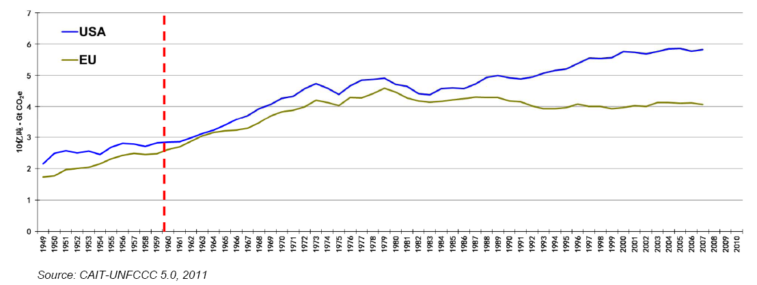
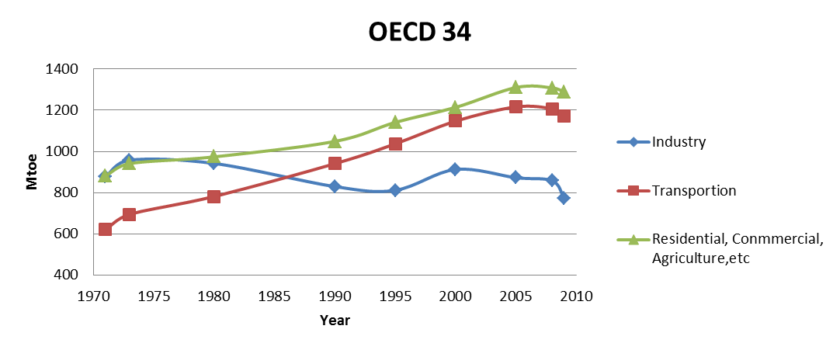
8. 我国工业化、城市化进程要走上绿色低碳发展路径，首先要促进产业转型，工业部门的能源消费和CO₂排放要率先达到峰值(2)
To achieve the goal of green and low-carbon industrialization and urbanization, the first step is to promote the industry transform and to advance the peak of energy consumption and CO₂ emissions from the industries. (2)
实现CO₂排放峰值，必须工业部门能耗持续下降，交通、建筑能耗的增加依靠发展新能源和可再生能源满足，化石能源消费和CO₂排放趋于稳定并逐步下降。
To achieve the peak of CO₂ emissions, the industrial energy use should be decreased continuously. The increasing energy demand from transportation and buildings should be supplied by developing new and renewable energy; fossil energy consumption and CO₂ emissions are to be maintained steady and decreasing gradually.

Slide 21
9.东部沿海发达地区要制定更为积极的低碳发展目标，在全国率先实现煤炭消费和CO₂排放峰值(1)
The developed eastern coastal areas should make more aspiring low-carbon goals to lead the country in reaching the CO₂ emissions peak(1)
东部发达地区人均GDP大都达10000美元左右，人均CO₂排放已相当或超过欧盟、日本人均CO₂排放峰值时水平。
The average income per capita in eastern developed areas is around 10,000 US dollars. The CO₂ emission per capita has already surpassed the CO₂ emissions per capita peaks of EU and Japan.
东部发达地区是能源资源短缺、环境污染严重地区，今年元月严重雾霾天气，燃煤排放是其首要成因。要实现煤炭消费和CO₂排放总量控制。
Eastern developed areas are short of energy resource and are facing serious pollution issues. The foggy and hazy weather in January this year was resulted primarily from coal combustion. The control over total coal consumption and CO₂ emissions should be enhanced.

Slide 22
9.东部沿海发达地区要制定更为积极的低碳发展目标，在全国率先实现煤炭消费和CO₂排放峰值(2)
The developed eastern coastal areas should make more aspiring low-carbon goals to lead the country in reaching the CO₂ emissions peak(2)
如仍持续当前发展模式，2020年很多地区的人均CO₂排放将远超欧盟、日本的水平，而直逼美国的人均水平。
If China continues to follow the current development pattern, the CO₂ emission per capita will far surpass the levels of EU and Japan and will reach that of the US.
北京市煤炭消费2005年已达到峰值，2011年已下降23%，人均CO₂排放2007年已到达峰值。
Beijing reached the coal consumption peak in 2005 and experienced a decrease of 23% in 2011. The CO₂ emissions per capita reached the peak in 2007.

Slide 23
10. 加快经济发展方式转变，是促进经济社会与资源环境协调，促进社会和谐和可持续发展的关键对策和重要着力点(1) Accelerating the change in economic development pattern is the key approach to coordinating economic and social development with resources and environment protection and the realization of a harmonious society. (1)
由资源依赖型、粗放扩张的高碳发展方式向创新驱动型、内涵提高的绿色低碳发展方式转变；
Change the development pattern from the extensive one characterized by resource intensive and high carbon into the intensive one characterized by innovation-driven and low carbon.
协调权衡GDP增长的收益与资源环境的损失，注重GDP增长速度和规模转变为更加注重质量和效益。
Paying equal attention to the gains from GDP growth and the losses from resource and environmental degradations associated, and giving more weights to the quality and benefits of economic growth than to the economic growth rate and the scale of the economy.

Slide 24
10. 加快经济发展方式转变，是促进经济社会与资源环境协调，促进社会和谐和可持续发展的关键对策和重要着力点(2) Accelerating the change in economic development pattern is the key approach to coordinating economic and social development with resources and environment protection and the realization of a harmonious society. (2)
经济增长由扩大投资、增加出口为主要驱动力转变为更加注重国内消费、改善民生、加强环保对经济发展的拉动作用。
Paying more attention to the role of domestic consumption and environment protection than of investment and export in economic growth.
投资在GDP中比重下降一个百分点，消费比重增加一个百分点，相应GDP能源强度将下降0.45个百分点。
1% of the reduction in the investment component of GDP with 1% of the increase in the consumption component of GDP can lead to 0.45 % of reduction in energy intensity of GDP.
加强法律法规和政策体系建设，为绿色低碳发展转型提供制度保障。
Creating enabling institutions for green and low carbon development by promoting low carbon legislation and policy system formulation.

Slide 25
Thank you for your attention！

