Slide 1
ADB’s Green Agenda
in the
People’s Republic of China
Ayumi Konishi
Director General, East Asia Department
Asian Development Bank
CCICED Annual General Meeting 2015
Forum
G20 and Green Finance
11 November 2015

Slide 2
Defining “Green Finance”

Slide 3
ADB’s Green Investment in the Region
Loan Amount and Number of Projects, 2010-2015
Corporate target: 3-year average of 50% in terms of number of projects in 2014-2016
Target exceeded in 2012-2014 at 51%
In terms of volume, 38% generates significant environmental benefits.
Estimate for 2014-2016 is 56%
Target: 50% in 2014-2016
Target: 25% in 2010-2012
Achieved: 43%

Slide 4
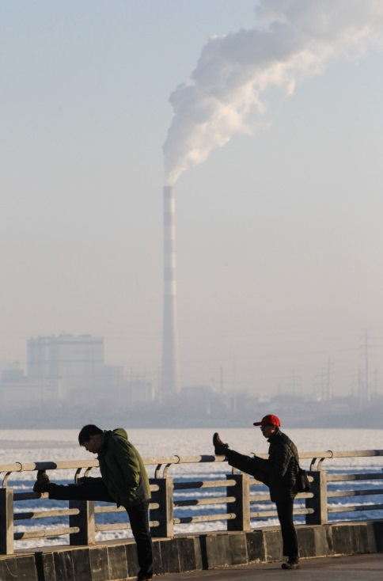
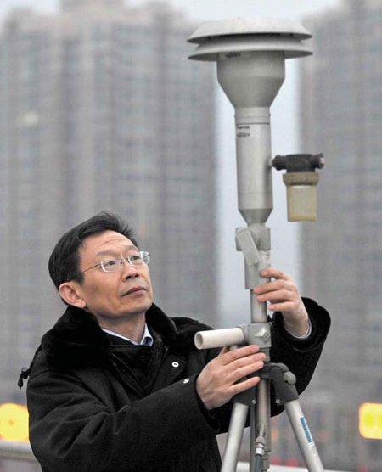
Two Aspects of Green Finance
Making all investments “green”
Securing financial resources for “green investment” in a narrower sense

Slide 5

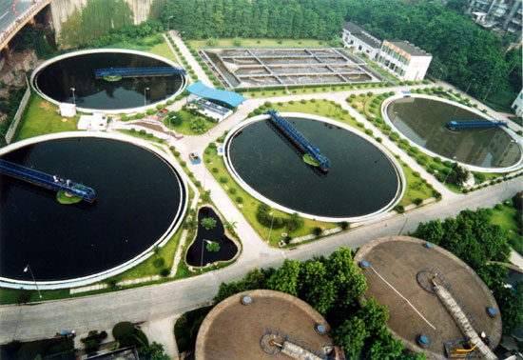
Demand for “Green Finance”
Sustainable Energy
Environmental remediation
Green Infrastructure
Industrial Pollution Control
Energy and Resources Efficiency

Slide 6


China’s Green Financing needs (2014-2020)
5 Trillion USD
or
30 Trillion RMB
Source: CCICED( 2015). Green Finance Reform and Green Transformation. Report of the green finance task force.

Slide 7

Key Challenges in Securing
Green Finance
Markets fail to recognize green development
High up-front capital costs and limited availability of long-term green financing
Local financial institutions lack capacity
Lack of appropriate regulatory/policy infrastructure

Slide 8
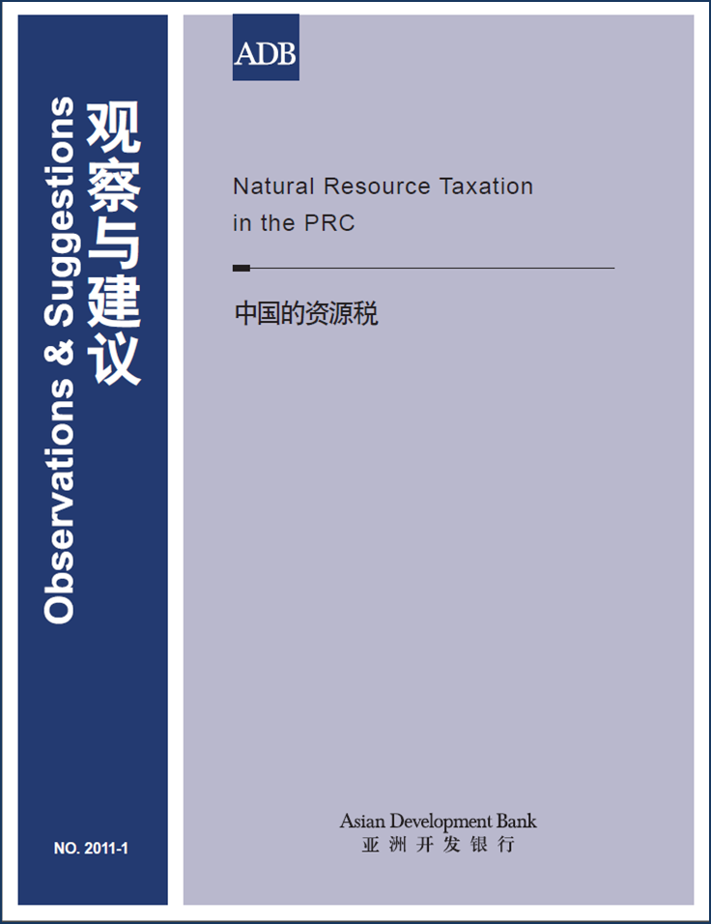
Recommendations for Green Financing in the 13th FYP (1)
(1) Reform Economic Incentives, Change Growth Patterns
    Resources prices and pollution charges
    Expedite natural resources and property taxes
    Introduce green taxation system

Slide 9
Recommendations for Green Financing in the 13th FYP (2)
(2) Reform Fiscal System
Address fiscal imbalance between central and local governments
    Recycle new revenue from taxes or fees to local governments to encourage their investments in environment
    A more programmatic approach for environmental investment
    Incentives needed to provide better rewards for the implementation of sustainable urban development

Slide 10
Green Financing
Strategic Focus and Priorities
Conventional (Loan)
Knowledge
Institutional Capacity Building
Leverage
Credit Guarantee
Innovation
Climate Change Financing (Emission Trading Scheme, etc.)
Private Equity Funds
Public Private Partnerships
ESCO Financing
Climate Change Fund
Poverty and Environment Fund
Risk Mitigation – Disaster Risk Insurance, CAT bonds , Carbon Market Program (CMP)
Policy Advisory
Knowledge Sharing
Researches on Green Financing
Water
Clean power generation
Energy efficiency improvement
Transportation
Urban
Agriculture

Slide 11
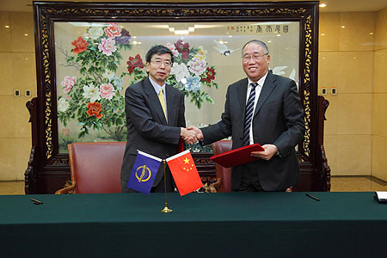
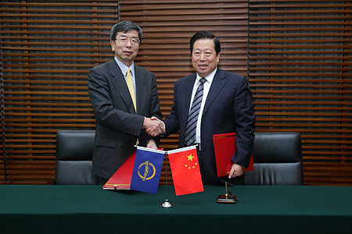
ADB Green Operations in the PRC Specific Cooperation Frameworks
ADB-MEP MOU on Clean Air, Water and Soil
ADB-NDRC MOU on Climate Change
Investments in BTH for air pollution control
Proposed initiatives for Yangtze river economic belt

Slide 12

Observations and Suggestions
Lessons Learned by ADB can benefit AIIB, BRICS Bank, and Silk Road Fund
Green Bank and Green Bonds
CDM Fund (also PPP center) and carbon emission trading

Slide 13
Thank You !

