Slide 1
“一带一路”绿色发展模式
Green Development Patterns of “One Belt One Road”
董锁成 首席研究员
中国科学院地理科学与资源研究所
Dong Suocheng
Leading professor，Institute of Geographic Sciences and Natural Resources Research, Chinese Academy of Sciences （dongsc3@163.com）

Slide 2
Contents
1
背景 Background
2
生态文明模式 Eco-Civilization Pattern
3
丝绸之路国际生态旅游带模式
International Eco-tourism Belt along Silk Road
4
国际生态环境合作模式International ecological environment cooperation

Slide 3
1. 背景 Background
2013年9月，习近平主席提出共建“丝绸之路经济带”和“21世纪海上丝绸之路”的战略构想，旨在促进沿线国家加强政策沟通，道路联通，贸易畅通，货币流通和民心相通，打造政治互信、经济融合、文化包容的利益共同体、责任共同体和命运共同体。实现沿线国家大合作，大发展，大繁荣。Chinese President Xi Jinping proposed to jointly build Silk Road Economic Belt and 21st Marine Time Silk Road in 2013, to strengthen policy communications, roads Unicom, trade flow, currency in circulation, and the people connected, Creating political trust, economic integration, cultural inclusion of the interests of the community, the community of responsibility and the fate of the community, and promote greater cooperation, development and prosperity among the countries of Asia, Europe and Africa.
“一带一路”沿线地区资源丰富，生态环境复杂多样、脆弱敏感，沙尘暴、干旱、水土流失、地震等自然灾害频发，经济发展差距大，陆上丝绸之路高空可能是污染、沙尘传输通道。Some areas along silk road are with rich resources, complicate，fragile and sensitive eco-environment, severe natural disasters of sand-storm, drought, water and soil erosion, earth quake, and sharp regional economic disparities among the countries, which is very likely the spatial transfer route of pollutants and dust.

Slide 4
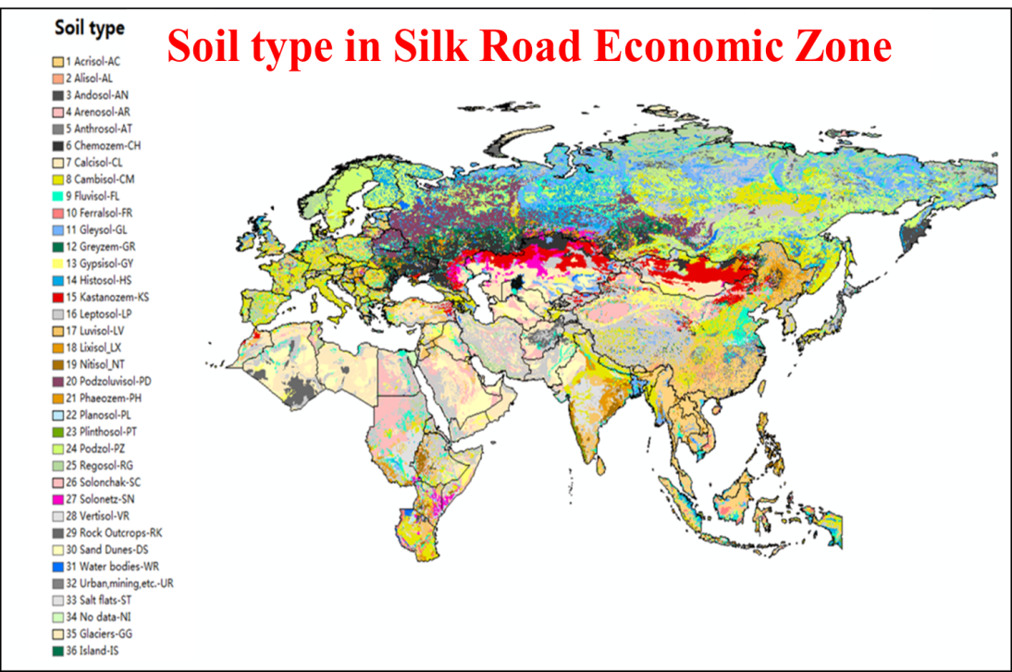
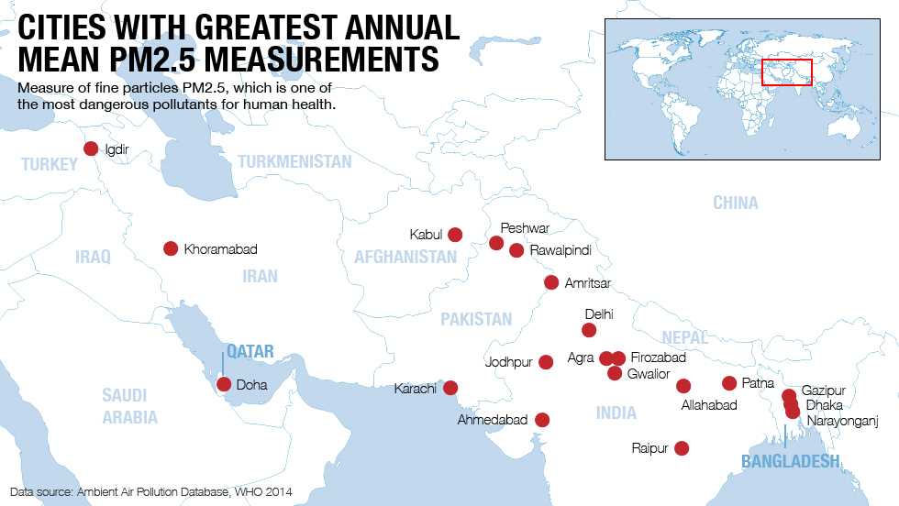
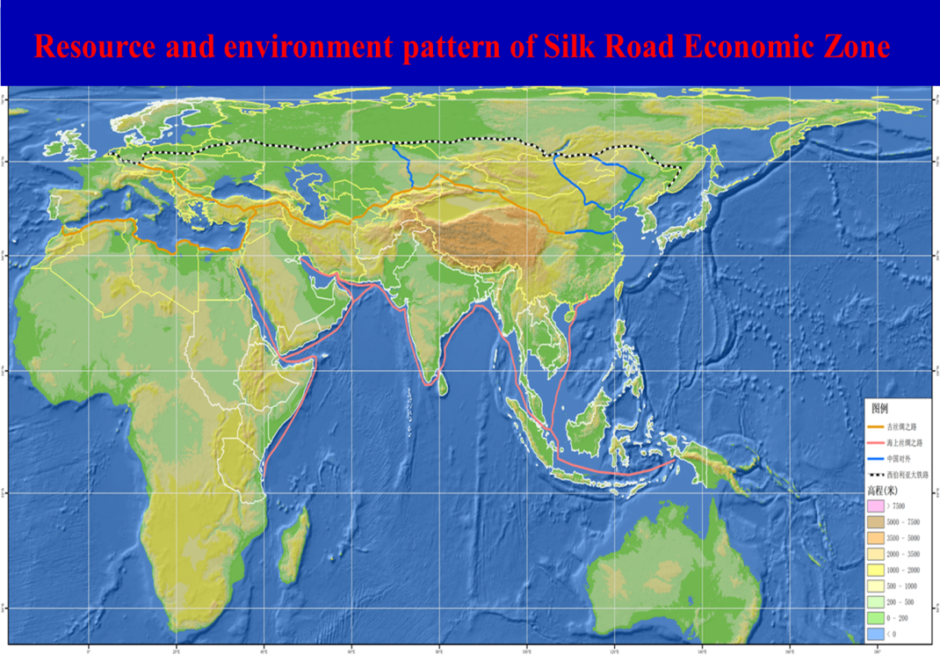
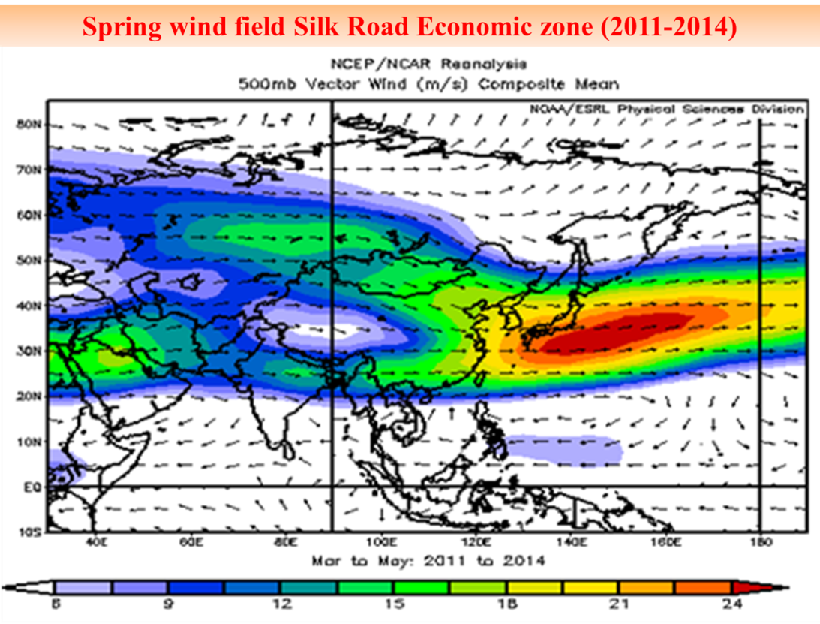
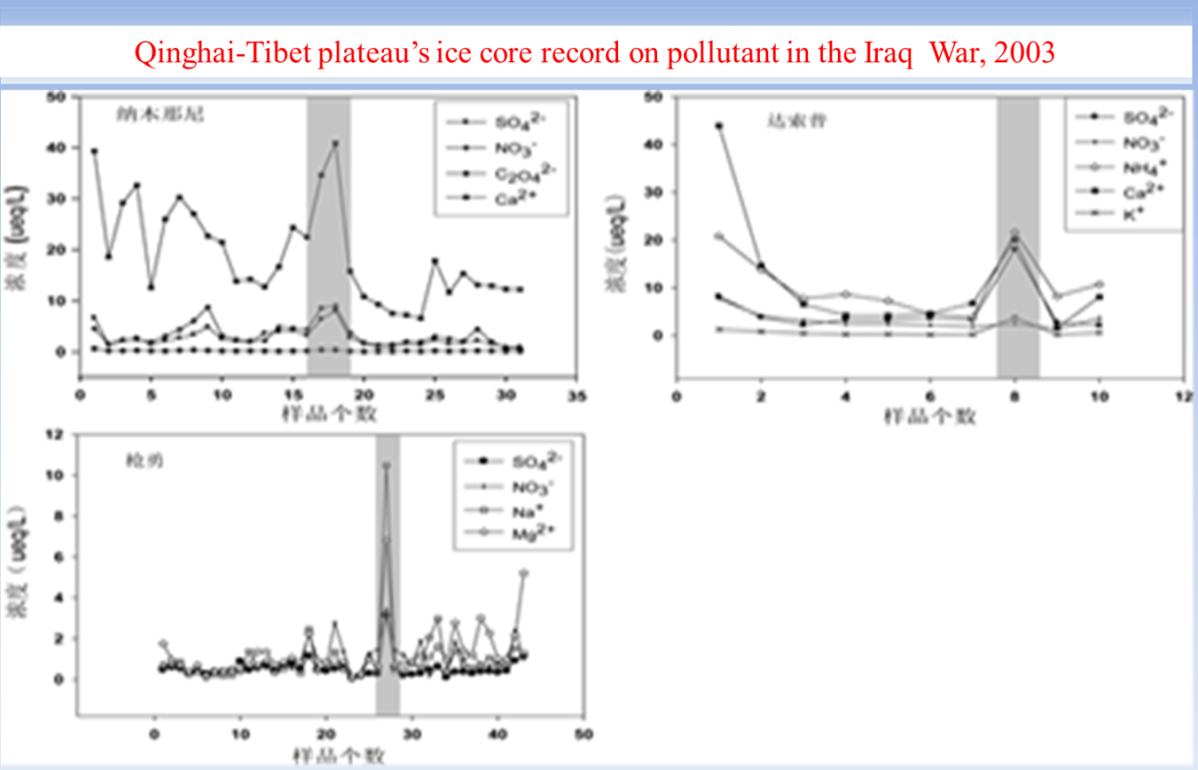
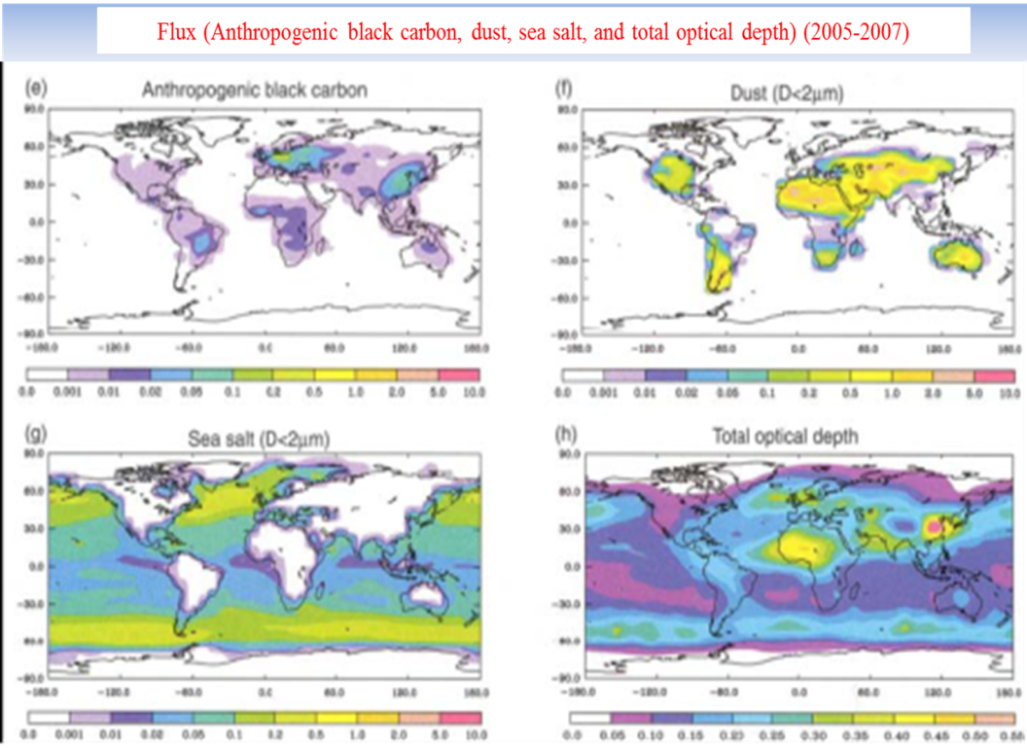
地理环境
复杂多样的土壤带
世界卫生组织-2014年世界
20个PM2.5最严重城市
受西风带控制
黑炭、沙尘、海盐成带
Land relief :The elevation of most area of the Silk Road is below 3500 meters, which accounts 95.96%. Below 200 meters accounts 31.30%, and below 1000 meters accounts 77.33%. This situation adapted for resource exploitation and economic development at various step.
青藏高原冰芯记录伊拉克战争的污染

Slide 5
2. 生态文明模式 Eco-Civilization Pattern
生态文明模式Ecological Civilization
Pattern
生态人居：
生态城镇、生态村
Eco-Human Habitant:
Eco-city
Eco-village
生态文化：中国天人和谐、现代生态学规律
Eco-Culture:
Chinese Man-Nature harmony
Ecology Laws
生态社会：循环社会
Eco-society：
Circular Society
生态经济：低碳产业、循环产业
Eco-Economy：
Low-carbon & circular industry
Green Energy
生态文明制度：生态法庭、生态文明委员会
Eco-Institution:
Eco-court，Eco-Civilization Committee
生态空间：低碳环境、自然保护区
Eco-Space:
Low Carbon & High Quality environment
Natural Reserves
人类经过农业文明，工业文明与自然的对立矛盾，正迈向生态文明阶段，即人与自然和谐阶段。其核心思想是尊重自然，顺应自然和保护自然，推动人类可持续发展。生态文明建设模式是绿色崛起战略，是绿色“一带一路”建设和可持续发展的首要战略模式。中国正在实施生态文明建设模式。
Human-beings created agricultural civilization and industrial civilization, in which man and nature were conflict and contradict. Human is marching towards Eco-Civilization, which establishes harmonious relationship between human and nature. The core ideology is to respect, obey, and protect nature, which is priority to Green “One Road One Belt” and its sustainable development. China is implementing Eco-Civilization Building Strategy.

Slide 6
四循环经济模式 Four Circular Economy
“一带一路”沿线与中国类似的国家要在在“3R”原则下，推进企业循环、产业循环、区域循环、社会循环的四循环经济，实现生产—流通—消费领域大循环经济。在沿线国家建立大循环经济体系和循环经济园区，促进绿色发展、循环发展、低碳发展。 It is vital for the Countries, like China, along silk road, to develop four sorts of circular economy, which are enterprise circular economy, industries circular economy, regional circular economy and social circular economy, formulating grade circular economic system through whole process of production, circulation and consumption, promoting green, circular and low-carbon development, at principle of Reduce, Reuse, Re-cycling .
四循环经济模式框图 Diagram of Four Circular Economy
企业循环
Enterprise circulation
生态设计 eco-design
清洁生产clean production
生态工业 eco-industry
产业循环
Industry circulation
生态农业 eco-agriculture
生态型第三产业 eco-tertiary
产业集聚
物质流 material flow
能量流 energy flow
信息流 information flow
循环产业园区 circular industrial park
交通线、市场网络、循环产业链
区域循环
Regional circulation
农村village
乡镇town
城市city
乡镇 town
农村 village
经济、社会、生态环境
社会循环
Circular Society
绿色消费
green consumption
生态文化
eco-culture
循环社会
Circular society

Slide 7
生态城模式 Six eco-city Diagram
和谐之城-最高层次要求，核心是高水准的生态文化与高度社会文明
创新之城：生态城市高级要求，科技和人才高度集聚，高科技产业发达，建设创新型城市。
和谐之城
harmony city
创新之城 innovation city
绿色之城-核心是城市生态景观和环境优美的人居环境，宜于居住和创业
绿色之城 green city
循环之城-生态工业循环产业链为核心，现代生态农业和生态型服务业为辅助的循环经济体系
循环之城 circular city
便捷之城-核心是公共交通主导的立体型交通导向城市布局
便捷之城 convenient city
安全之城 safe city
安全之城-最基本要求，核心城市社会秩序良好，基础设施完善，综合防灾水平高
生态城市 eco-city
生态镇 eco-town
生态社区eco-community

Slide 8
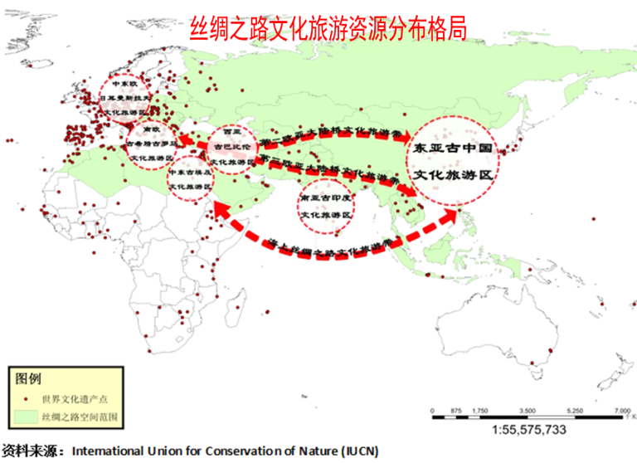
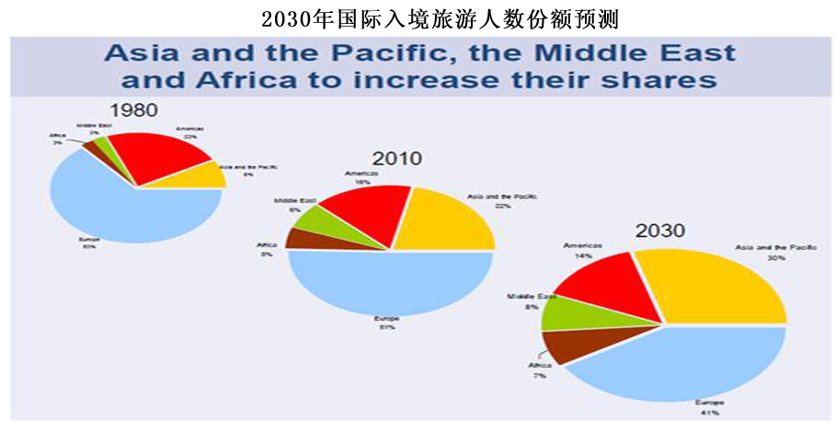
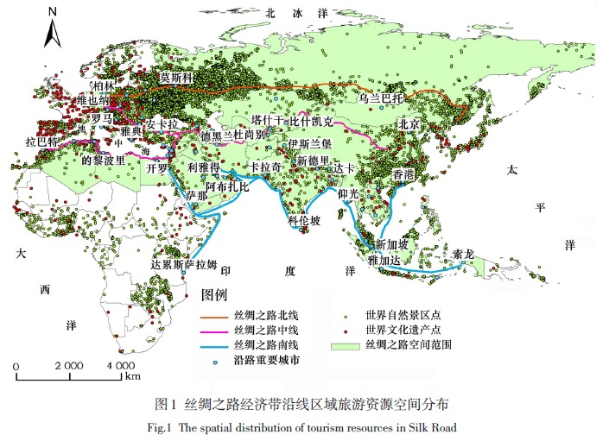
3. 丝绸之路国际生态旅游带模式 Mode of international tourism economic belt along Silk Road
一带一路沿线是世界旅游资源最丰富区域，旅游增长最快区域，未来市场潜力最大区域。Regions along silk road are with the advantages of the richest tourism resources, fastest growth of tourism industry and highest potentiality of the world, in the future.
携手共建丝绸之路国际旅游带是建设绿色一带一路的优先战略 Building international tourism belts along Silk Road is the priority strategy to Greening One Road One Belt.
建设丝绸之路国际无障碍旅游区和国际旅游经济特区 Establishing the Building international barrier-free tourism zone and special tourism economic zone along Silk Road to push the development of the Silk Road regional economic integration.
重点突破跨国互联互通瓶颈, 建设高效快捷国际旅游交通网络 Break through traffic bottleneck and construct High Speed Train, airlines, express way communication network .

Slide 9
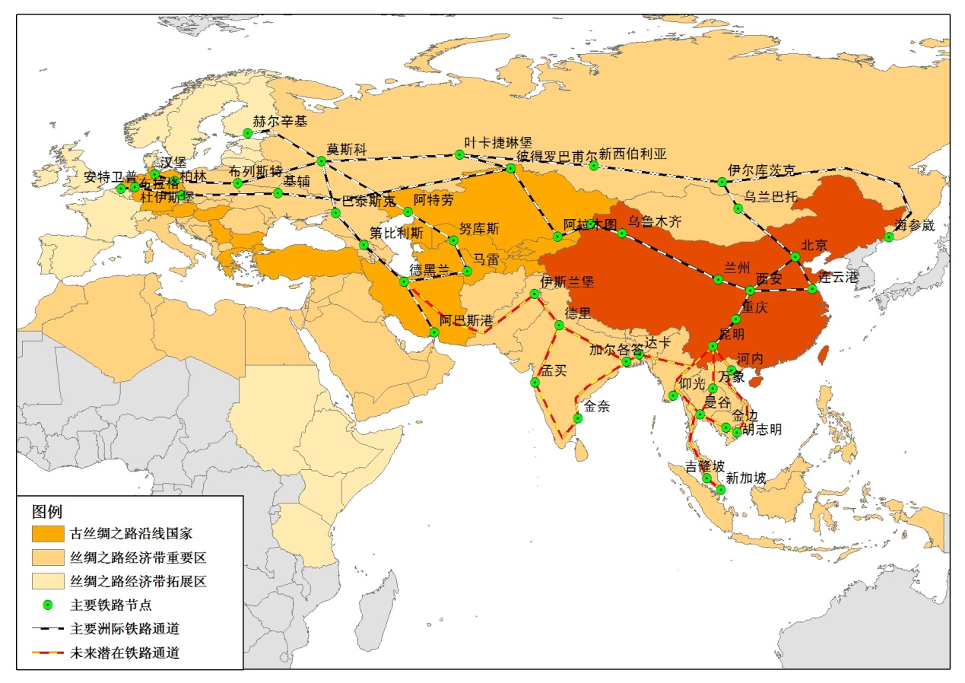
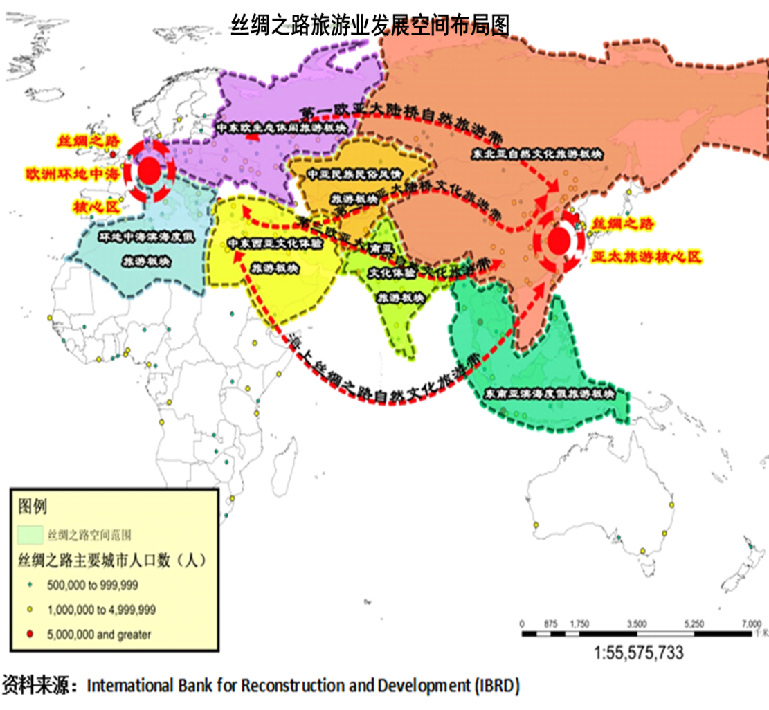
建设丝绸之路国际旅游联盟和丝绸之路著名城市旅游网络 Building international tourism union and urban tourism network along the Silk Road.
丝绸之路国际旅游带
international tourism belt along Silk Road
丝绸之路著名城市旅游网络
Urban tourism network

Slide 10
4. 国际生态环境合作模式 International ecological environment protection cooperation
共建“一带一路”生态环境与可持续发展国际科学家联盟和智库 Establishing International Scientists Consortium and Think Tank, Scientific Policy-making System of ecological environment and sustainable development of One Belt One Road
建立应对气候变化和生态环境跨国合作共赢机制，共同应对全球变化和极端环境事件及自然灾害 Founding transnational construction and win-win cooperative mechanism of response and adapt to global climate change and extremely eco-environment events and natural disasters .
建立一带一路生态环境监测预警应急系统 Building monitoring and early warning and emergency system of eco-environment of One Belt One Road.
协同推进跨国生态修复工程，加强沙漠化治理技术合作，加强水资源高效配置利用和农业节水灌溉技术合作 Collaboration on transboundary pollution & ecological restoration engineers, controling desertification technologies，using and distribute valued water resource effectively, and cooperate with water-saving irrigation technologies.

Slide 11
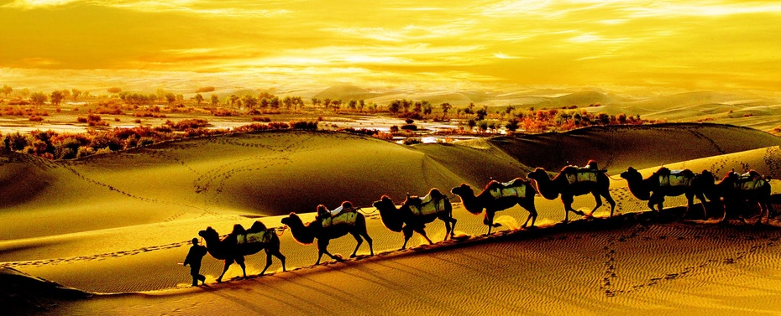
Thank You !

